Slide 1



Incorporating Trauma-Informed Principles
When Eliciting a Patient Health History
Notes:
Welcome to “Incorporating Trauma-Informed Principles When Eliciting a Pediatric Patient Health History”. This slide set is a framework for instructors to follow to facilitate in delivery of trauma-informed care education. Helpful information, tips and resources will be available at the bottom of each slide for additional reference.

Slide 2
Learning Objectives
Understand the importance of approaching a patient health history using a trauma-informed perspective
Identify potential health history elements/questions that might be challenging
Incorporate trauma-informed principles in new and ongoing patient encounters
Notes:
A clinician's first introduction to a patient is often through a health history and physical exam. This initial interaction can set the tone for how safe the patient feels within this therapeutic relationship. Efforts to create a safe environment through the initial history taking process can help support the development of a trusting patient-provider relationship.

Slide 3
Let’s start with a few scenarios we may see in practice:
A patient feels angry and targeted when a provider asks if they would like to be screened for sexually transmitted infections, like gonorrhea and chlamydia.
A patient who learns they are pregnant as a result of rape.
A patient with a maternal history of breast cancer who tearfully presents for care when she finds a new breast mass on self-breast exam.
A transgender patient who is weary of seeking healthcare as they have been repeatedly misgendered and “dead named” by other providers.
An African American patient who has experienced racism and discrimination by healthcare providers is distrustful of the healthcare system and of white providers.
Notes:
When thinking about these scenarios and how the patients may feel in these situations, this may give you a moment to consider that the reactions that we see may not fit our anticipated reactions. However, when considering the backgrounds or prior traumas that patients may have experienced, their reactions may make more sense.

Slide 4
What is “trauma”?
Event
Experience
Effects
“Trauma” = potentially distressing event / experience
“Traumatic stress” = reactions to that experience
Notes:
Many of our patients will enter care with histories of trauma, with some entering care while currently experiencing traumatic events (intimate partner violence, community violence, workplace violence, etc.). And, regardless of prior experiences, aspects of medical events and treatment can themselves be stressful or potentially traumatic. It is for these reasons that nurses should approach all patient/nurse interactions using a Trauma Informed approach. Importantly, while a traumatic experience can happen to someone, it is not their identity.
It is important to note that nurses may be bringing their own histories of trauma and experiences that may shape the way that they deliver care and how they respond to the experiences that they encounter while in their roles.
References:
Substance Abuse Mental Health Administration (SAMHSA) - https://ncsacw.samhsa.gov/userfiles/files/SAMHSA_Trauma.pdf

Slide 5
Understanding the Impact of Emotional Trauma
Realize
Recognize
Respond
Resist
the widespread impact of trauma and understands potential paths for recovery
signs and symptoms of trauma in patients, families, staff and others involved in the system
by fully integrating knowledge about trauma into their practice, as well as into policies and procedures
Seeks to actively resist re-traumatization
Notes:
The “4R’s” of Trauma Informed Care are assumptions that support a nurse’s Trauma Informed approach to developing, engaging, and maintaining successful patient/nurse interactions.
Nurses innately engage in this type of care. It is through a shared language that this is recognized and enhanced. The overall approach is to recognize that many people in caring professions do this naturally, but don’t necessarily name it as “Trauma Informed Care.” The purpose of naming this approach is to codify and strengthen these activities and approaches and add to a nurses’ toolbox.
Larger systems or organizations should also consider how the 4R’s frame the way in which services are developed, delivered, and evaluated with and for their patient population. Within the organizational framework, this consideration is also extended to all staff engaged in delivering Trauma Informed Care
----
Realizes
In a Trauma Informed approach, there is a basic realization about trauma and an understanding of how trauma can affect individuals, families, groups, organizations, and communities. People’s experience and behavior are understood in the context of coping strategies designed to survive adversity and overwhelming circumstances, whether these occurred in the past (i.e., a client dealing with prior child abuse), whether they are currently manifesting (i.e., a patient’s distress or worry about their current medical condition or procedure, a staff member living with intimate partner violence in the home), or whether they are related to the emotional distress that results in hearing about the firsthand experiences of another (i.e., secondary traumatic stress experienced by a direct care professional or by a patient’s accompanying family member).
There is an understanding this that trauma plays a role in mental and substance use disorders and should be systematically addressed in prevention, treatment, and recovery settings. Similarly, there is a realization that trauma is not confined to the behavioral health specialty service sector, but is integral to other systems (e.g., child welfare, criminal justice, primary health care, peer–run and community organizations) and is often a barrier to effective outcomes in those systems as well.
In healthcare we realize that all patients and their families could potentially be afflicted by prior or existing trauma and that it is recommended to approach trauma as more of a universal precaution.
The response to this trauma may be seen through behaviors and reactions in interactions with the healthcare system. It is especially through obtaining a health history where we may first see signs of this trauma and how it impacts the behaviors and actions of patients and families and the relationships the develop with providers.
Recognizes
Healthcare professionals are charged with the task of recognizing the signs of trauma, but also approaching trauma as a universal precaution. This assists the healthcare team in ensuring that all patients, families, and staff are treated as if they have a trauma history. By caring for all patients and families and collaborating with colleagues as if they have a trauma history, regardless of knowledge of past experiences, enables healthcare professionals to appropriately interact without needing to know the trauma that has been experienced. In the event that patients, families or staff are expressing signs and symptoms associated with trauma, the healthcare professional who is Trauma Informed will recognize these signs and symptoms and proceed appropriately. Workforce development, employee assistance, and supervision practices supports Trauma Informed practices.
Responds
Healthcare providers respond by applying principles of a Trauma Informed approach to all areas of care. A nurse who is Trauma Informed understands that the experience or traumatic events impacts all people involved, whether directly or indirectly and, with their colleagues, responds appropriately. When caring for all patients, especially through actions such as a physical assessment or procedures that may be uncomfortable, it is important that a healthcare provider implements strategies that support Trauma Informed practices. A healthcare system that is Trauma Informed responds to trauma by fostering an environment in which language, behaviors and policies support the staff through ongoing evidence-based education and training, as well as ensuring that relevant policies are implemented, evaluated, and updated as appropriate
Resist
A Trauma Informed approach seeks to resist re-traumatization of patients, families, and staff. Because of the nature of the healthcare environment, trauma may be unavoidable, but it is important that the goal of resisting re-traumatization is paramount and that recognition of new trauma that may be experienced is promptly recognized and responded to appropriately. Additionally, some environments and organizations inadvertently support stressful or toxic environments that interfere with the treatment and recovery of patients, families, and staff. Being a Trauma Informed healthcare provider means recognizing how organizational practices and factors may create new trauma, trigger painful memories, and/or retraumatize patients and their families. For example, providers recognize that using restraints on a person who has been sexually abused or placing a child who has been neglected and abandoned in a seclusion room may be re-traumatizing and interfere with healing and recovery.
REF
Substance Abuse Mental Health Administration (SAMHSA) - https://ncsacw.samhsa.gov/userfiles/files/SAMHSA_Trauma.pdf

Slide 6
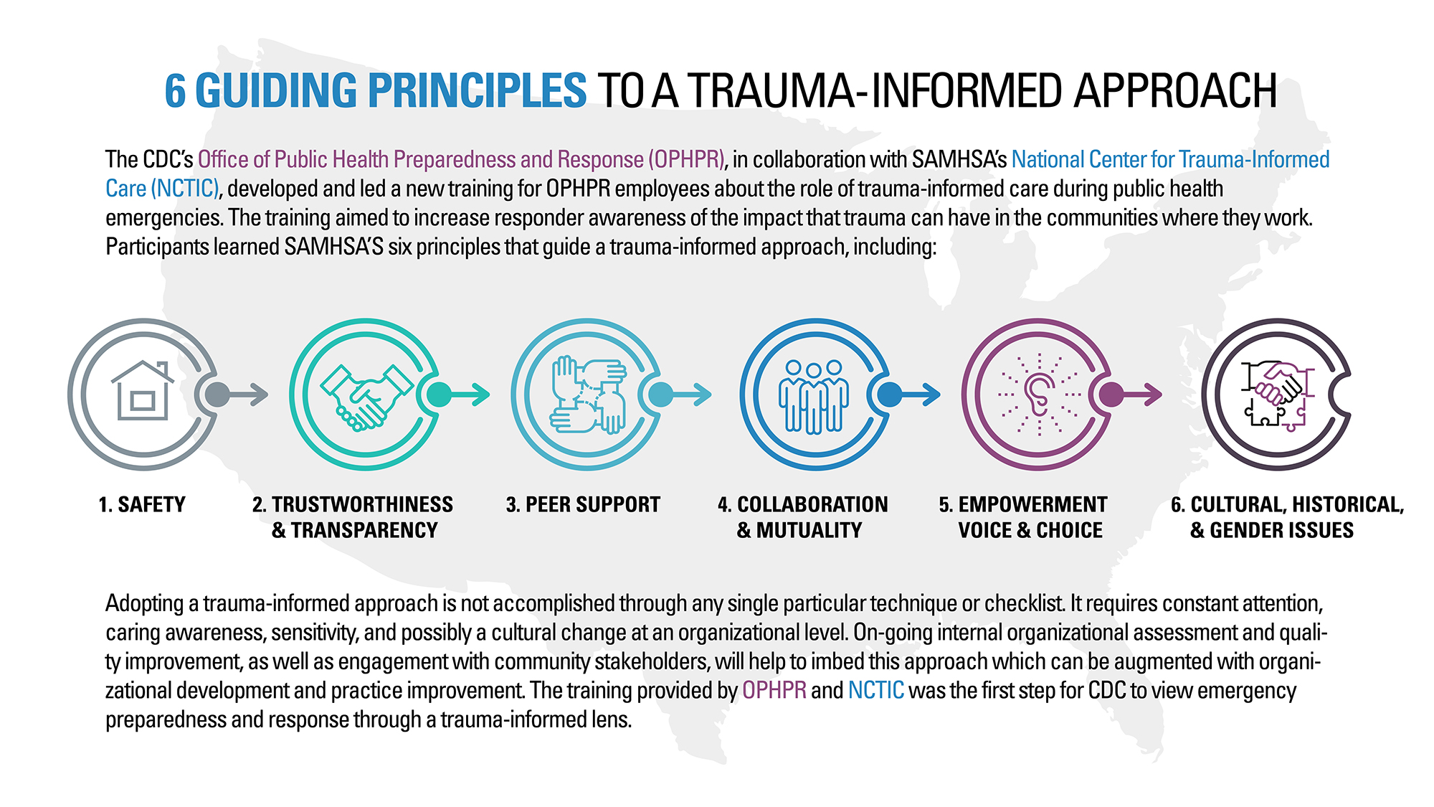
The Six Trauma-informed Principles
https://www.cdc.gov/cpr/infographics/6_principles_trauma_info.htm
Notes:
Nurses should view the Six Trauma Informed Principles as a loose conceptual framework from which nurses’ interactions with patients, families, and peers can be considered, enacted, and evaluated. Thoughtful evaluation of patient/nurse interactions will likely demonstrate that nurses can and do routinely employ multiple Principles concurrently. As nurses consider their interactions with patients in light of the Six Principles, some questions should be posed (examples include):
Are there specific Principles they find easier to apply? More challenging to apply?
Does application depend on individual patient's situation?
Is bias involved?
Are there system wide resources or trainings that could be developed and deployed to help support inclusion of these Principles in a more responsive way?
Are there barriers (time, personnel, space, organizational culture, etc.) to incorporating these Principles that can be addressed?
Safety: For patients to feel safe, it is important to recognize that emotional as well as physical safety are necessary while obtaining a health history and/or physical exam. Recognition of ways that providers can facilitate safety for patients and caregivers and taking the actions to facilitate a safe space for exchange of information is paramount.
Trustworthiness and Transparency: To foster trustworthiness and transparency, patients must believe and feel that their well-being is paramount for the provider that they are working with within the context of their relationship. They must feel comfortable that their patient/nurse relationship is built on trust and open communication about concerns, needs, and treatment. Transparency and trust are evident through practice and policies.
Peer Support: Peer support and mutual self-help are important ways to foster safety and hope, build trust, and enhance collaboration between patients, providers, and staff. It is important that patients recognize that peer support can be helpful should experiences and encounters reintroduce past trauma. Providers must recognize that they also have support available in their peers in their roles.
Collaboration and Mutuality: Nurses should recognize and attempt to reduce real and perceived power imbalances in their encounters with patients and families. Authentic collaboration between patients and providers around treatment plans helps to promote an environment in which there is mutual respect and embraces the strengths that each party brings to the patient/nurse interaction. Patients and families should be viewed as valuable members of the care team who are equipped with the tools to collaborate with providers in the management of their care.
Empowerment, Voice and Choice: A Trauma Informed approach recognizes and builds upon the strengths of patients, caregivers, and providers and ensures that they are empowered to express their choices and use their voices when it comes to their care and treatment. Key elements of empowerment, voice, and choice include supporting patients and caregivers in shared decision-making and active engagement in treatment plans, encouraging and supporting self-advocacy, and ensuring staff are equipped with the tools necessary ensure that these voices and choices are heard.
Cultural, Historical, and Gender Issues: To provide Trauma Informed Care, healthcare organizations and healthcare providers must: 1) actively identify and challenge cultural stereotypes and biases (e.g. based on race, and ethnicity, sexual orientation, age, religion, gender identity, geography, etc.); 2) offer access to gender responsive services; 3) leverage the healing value of traditional cultural connections; 4) incorporate policies, protocols, and processes that are responsive to the racial, ethnic, and cultural needs of individuals served; and 5) recognize and address historical trauma.
REF
Substance Abuse Mental Health Administration (SAMHSA) - https://ncsacw.samhsa.gov/userfiles/files/SAMHSA_Trauma.pdf
Foli, K. J. & Thompson, J. R. (2019). The Influence of Psychological Trauma in Nursing.

Slide 7
Considerations
Pre-Visit Review of Medical History
Introductions
Privacy, Confidentiality, and Safety
Provider Body Language and Use of Physical Self
After the Health History (or Exam)
Documentation
Challenges You May Face
Notes:
This brief review, which focuses specifically on taking a trauma informed health history, is intended to build upon existing foundational knowledge a provider has likely gained through previous study. While some suggestions offered in this review might seem second nature to experienced providers, our goal is to highlight how these suggestions “fit” within the Six Trauma Informed Principles highlighted in Slide 2. These suggestions are not exhaustive but rather, provide a frame of reference for providing Trauma Informed Care in a variety of settings.
*It is important to note that using this Trauma Informed approach does not necessarily equate to taking a trauma history. In some cases, we may not routinely ask about any trauma and instead operate under a “universal precautions” model.

Slide 8
Pre-Visit Review of Medical History

Slide 9
Pre-Visit Review of Medical History and Reason for Visit
Before meeting the patient, providers should review patient’s preferred name, pronouns, past medical history, and reason for the visit (paying specific attention to medical history surrounding this visit). It is also possible that the patient may have disclosed past or current trauma during previous clinical encounters.
Notes:
TIC Principles: Reviewing the patient information prior to meeting with the patient supports a Trauma Informed interaction by allowing the patient to feel like they are working with a provider who is aware of their preferences, history, and reason for visiting. This fosters a sense of safety, supporting trustworthiness & transparency between the patient and caregiver and health care team. It also embraces the principal of empowerment, voice, & choice by encouraging the patient and their caregiver to share their preferences. Reviewing this information also considers any cultural, historical and gender issues that the patient may face

Slide 10
Pre-Visit Review of Medical History and Reason for Visit
Identify if the patient has previously noted a preference for how they would like to be greeted in the clinical encounter.
Some patients might prefer
A formal greeting (Mr./Ms./Mrs./Dr.)
An informal greeting (first name or nickname)
A name that differs from their given name/name used for insurance
Pronouns that are inconsistent with cis-gender names.
Notes:
Greeting the patient in a manner in which they are most comfortable can help build a relationship based on safety, trust, and respect, which is especially important for people who might have experienced stigma, discrimination, and abuse in their lives, including in previous clinical encounters.
While reviewing the patient’s medical history to learn if the patient has previously identified their pronouns can be helpful in establishing rapport, nurses should recognize that a patient’s pronouns might differ from what is stated in their medical history or might have changed since the last clinical encounter. Nurses should note that the phrase “preferred pronouns” is no longer used – it is just “pronouns.”

Slide 11

Pre-Visit Review of Medical History and Reason for Visit
Reviewing the patient’s medical history and reason for visit provides important information that will help the clinical encounter be more efficient and may help patients and caregivers feel the nurse is familiar with their previous care.
Notes:
Continuity of care is important for establishing quality care and for building trust within the patient/nurse relationship, which is especially important for people who have experienced trauma. Reviewing the patient’s health history in advance of the clinical encounter might save the patient from having to reiterate health data, some of which might be uncomfortable to recount, which might be re-traumatizing.
Nurses should be aware that some health history topic areas, especially sensitive health data, might have been intentionally omitted by the patient in previous clinical encounters. This can be a result of a variety of factors, some of which might be related to past or current trauma and feelings of safety and trust. Nurses should avoid judging the patient for any past omissions and attempt to clarify relevant missing data and primary concerns as appropriate.
The patient’s listed reason for current visit may not be the thing that they are actually most concerned about. For example, a patient might schedule an appointment for “abdominal pain” but might really be concerned about a recent exposure to a sexually transmitted infection. This seeming incongruence might be related to a variety of factors, including the patient’s level of comfort and trust with the nurse, other people who might have been present when the patient was completing any initial intake paperwork, etc. It is important to provide a nonjudgmental space for a patient to clarify their clinical goals.

Slide 12
Pre-Visit Review of Medical History and Reason for Visit
Review the patient medical history to
determine if past or current trauma was
disclosed in past clinical encounters.
Notes:
While nurses should approach all clinical encounters using a trauma informed approach, it can be helpful to know if the patient disclosed trauma in previous clinical encounters, especially if there was a proposed action plan developed for future clinical encounters (i.e., using a chaperone, separating future appointments into multiple visits, allowing/not allowing nursing and medical students to be present during the exam, etc.)
While recognition of past trauma can be valuable, nurses should also be mindful that not all healthcare concerns are linked to past/current trauma. This is especially important when working with patients who have experienced having their physical symptoms dismissed by providers as “psychosomatic.”

Slide 13
Provider Introduction

Slide 14
Nurses should begin all clinical encounters with an introduction of themselves to the patient.
Provider Introduction
Notes:
It is hard to believe, but not all nurses begin a clinical encounter by introducing themselves to their patient. This is a missed opportunity to establish rapport, especially if this is a new clinical encounter.
Many of these recommendations help to establish a sense of safety, trustworthiness, and transparency – all key Trauma Informed Care Principles.

Slide 15

Initial introduction and health history should be completed with the patient fully clothed.
Provider Introduction
Notes:
TIC Principle: Safety; Collaboration and Mutuality - For many people, including those with a trauma history, being disrobed may be uncomfortable or threatening. There is no medical reason for the patient to be partially unclothed during the introduction and health history portion of the clinical encounter (other than provider and practice efficiency). Allowing the patient to stay fully clothed during the health history can increase a patient’s sense of safety and comfort during the discussion. This may help reduce a sense of power imbalance and set the stage for a more collaborative, open, and therapeutic encounter.

Slide 16
When making an introduction, the nurse, if comfortable, should identify their own pronouns. Additionally, nurses should ask the patient their pronouns if they are not identified in the patient’s chart.
Provider Introduction
Notes:
TIC Principle: Safety; Trustworthiness and Transparency; Empowerment, Voice and Choice; Cultural, Historical, and Gender Issues - Providing one’s own pronouns and asking the patient their pronouns might help convey that the nurse is aware that gender is a spectrum and that this is a safe space. This can help create an environment of safety and trust. Nurses should be aware of and respect that not all patients are comfortable with sharing their pronouns and should be empowered to make the best choice for themselves. Reluctance to share pronouns might be especially true if other people are also present in the exam room (for example, family members, children, other medical professionals). While some cisgender patients might question a nurse's query around pronouns (“Why is everyone suddenly talking about pronouns?”), this might provide an opportunity for the nurse to educate all patients about gender identity.

Slide 17
During the introduction, gauge the patient’s comfort with shaking hands and using direct eye contact when communicating
Provider Introduction
Notes:
TIC Principle: Cultural, Historical, and Gender Issues; Empowerment, Voice & Choice - Gauging the patient’s comfort of communication with the health care professional is important to consider. For example, not all patients will feel comfortable with shaking hands or making direct eye contact with the nurse. These preferences might be related to many things including comfort level, cultural and gender norms, and trauma history. These boundaries should be respected and documented for future encounters. It is through empowerment, voice & choice that providers support the patient’s ideal communication style that allows them to communicate in a way that feels most appropriate to them.

Slide 18
Do not assume the patient is comfortable with other individuals being present in the room for the history or the physical exam
(e.g., medical or nursing students, nursing assistants, etc.). Ask their permission before introducing other providers into the clinical encounter.
Provider Introduction
Notes:
When asking the patient for permission to include other healthcare providers in their care, do not assume the patient understands what each medical professional’s role is (e.g., resident, attending, intern, student, etc.). Use plain language to describe their roles and responsibilities and how that specifically relates to their care (e.g., listening only, asking questions, leading the encounter, second opinion, etc.). Patients have the right to not have students involved in their care, even if they are receiving care in a teaching hospital/clinic.
Some patients might request to have a 3rd party in the room during their clinical encounter (e.g., other medical staff/chaperone, a trusted family member, or their young child/children). When possible, these requests should be granted.
Some patients might need support from the nurse in asking family members or partners to leave the exam room during the health history and physical exam. This may be especially true in cases of intimate partner violence. Mechanisms should be in place to allow for private encounters between the patient and the nurse.
TIC Principle: Safety; Empowerment, Voice, & Choice; Transparency and Trustworthiness - Patients should decide for themselves if and how other individuals should be involved in their care. Honoring their voice and their choice is paramount to developing a safe, respectful and trusting patient/nurse relationship.

Slide 19
Privacy, Confidentiality, and Safety

Slide 20
Providers should ensure that the location in which the health history takes place is as private as possible while also safe.
Privacy, Confidentiality, and Safety
Notes:
Ensure exam room doors are closed and/or curtains are closed. In some instances, it might be appropriate to ask the patient if it is ok to close the door (“is it ok that I close the door?”).
If the exam “room” consists of a section blocked off by privacy curtains, consider turning the exam table toward the wall so that patients are not exposed when the curtain is opened.
TIC Principle: Safety. During the health history it is important that the conversation takes place in an area in which the patient and caregiver feel comfortable and safe sharing the information needed. Patients should feel that the information that they share will only be heard by the provider and not others in the patient care area. This fosters an environment of confidentiality and allows for patients to share information regarding their current visit and/or health history, which may or may not be traumatic

Slide 21
Providers should identify to patient and caregiver what, if any, information they are required to report to outside agencies or authorities (e.g., suspected child abuse or neglect, weapons possession, substance abuse, suicidal or homicidal ideation, etc.)
Privacy, Confidentiality, and Safety
Notes:
Understanding what information must legally be reported to external agencies/authorities can help the patient decide what information they wish to disclose. This type of explicit transparency can help establish trust between the patient and nurse. Nurses might be concerned that patients might choose not to disclose abuse out of concern for what is legally reportable. It is important for the nurse to consider that the patient is making an informed decision at that time based on information that might be unknown to the provider. For example, a patient might be planning to leave an abusive partner in the near future but needs to develop a safety plan first – early disclosure might put her plan and her life in jeopardy.
In cases of intimate partner violence, reporting victimization without the victim’s consent can replicate the power and control dynamics common in many violent relationships. Nurses are required to report any actual or suspected child abuse, regardless of their patient's consent.
TIC Principles: Safety; Trustworthiness, & Transparency, Empowerment, Voice, & Choice – Recognizing these Trauma Informed Principles allows patients to understand that this is a place of safety and that certain protocols are in place to keep the patient as safe as possible. Through this transparency, patients can choose what information they want to share while also understanding the role of the provider in helping to ensure their safety. At the same time, the provider is being transparent that there are some things that they are required to report to ensure the safety of all.

Slide 22
Providers should acknowledge upfront that some health history questions might be of a sensitive nature (e.g., sexual health, mental health, substance use, etc.).
Privacy, Confidentiality, and Safety
Notes:
Acknowledge that these sensitive questions are routine and are asked of all patients seeking care. This can help the patient feel like they are not being singled out, targeted, or stereotyped.
Providers should proactively give patients permission to: 1) request to know why a question is being posed (“What does that have to do with why I am here today?”; 2) decline to answer a question (“I am not comfortable answering that question’); 3) answer the question at a later point in the clinical encounter (“I would like to come back to this question at a later time during our clinical encounter”); and/or 4) clarify previous answers (“I want to add something to an answer I already gave.”). Normalizing a patient's informed involvement in their own care and recognizing that responding to sensitive questions might require patience, time, and clarification, can help reduce patient/nurse power imbalances and establish trust.
TIC Principles: Safety; Trustworthiness and Transparency; Empowerment, Voice & Choice – Being asked to respond to sensitive health questions can make people feel vulnerable to judgement and stigma. Ensuring the environment is safe to disclose sensitive information, that the information is relevant to a patient’s care, and that patients are empowered to ask questions of the provider and choose what information they wish to disclose, can help support a safe and trustworthy patient/nurse relationship.

Slide 23

When possible, try to position the patient’s chair in a way that does not make them feel boxed in or trapped. Additionally, avoid having a patient’s back facing the door.
Privacy, Confidentiality, and Safety
Notes:
TIC Principles: Safety - Ensuring that the patient feels as though they are in control of their physical environment can help increase a sense of safety and reduce anxiety, fear, and apprehension.

Slide 24
Preferred language of patient and caregiver should be documented. Should interpretation be needed for the clinical encounter, the provider should engage with a professional interpreter or the language line.
Provider Introduction
Notes:
TIC Principles: Safety; Collaboration & Mutuality Empowerment, Voice & Choice; Cultural, Historical & Gender Issues - Using professional interpreters or the language line can help ensure that communication between the nurse and the patient is accurate and complete, which is vital to providing quality care and respecting the patient's individual needs and allowing them to voice their specific needs and concerns. Additionally, using a patient’s family member or child/children to interpret the clinical encounter may limit what the patient feels comfortable disclosing and may result in inaccurate information being obtained. Additionally, disclosure of sensitive health information by family members or children to others might be culturally inappropriate and also place the patient (and their family members and children) in danger.

Slide 25
Provider Body Language and Use of Physical Self

Slide 26
Speak clearly and calmly at an acceptable volume.
Provider Body Language and Use of Physical Self
Notes:
Use simple, clinical language.
Be clear in requests or instructions if an exam is necessary.
TIC Principles: Safety; Trustworthiness & Transparency; - Communication with patients and caregivers is an opportunity to foster a safe and trustworthy environment. It is important to speak at a volume and rate that allows patients and caregivers to feel comfortable and aware of what is taking place.

Slide 27

Sit/stand/kneel at eye level with patient.
Provider Body Language and Use of Physical Self
Notes:
Sitting at eye level helps to avoid an imbalance of power or replicate feelings of being deferential to an authority figure.
*It is important to note, some cultures may not want the nurse at “eye level” so while this is a common practice, we should be aware*
TIC Principles: Safety; Trustworthiness & Transparency; - Meeting the patient at their eye level creates an environment in which the patient and caregiver do not feel that the provider is in a position of power. This allows patients and caregivers to understand that they and the provider are on the same level and that the patient is safe.

Slide 28
Always attempt to stay in the patient’s sight.
Provider Body Language and Use of Physical Self
Notes:
When possible, avoid standing or asking questions out of the patient’s view.
TIC Principles: Safety, trustworthiness & transparency – Keeping in the patient and caregivers view allows the patient to be able to see what the provider is doing. It is important that the patient and caregiver are able to anticipate what is going to happen next and that they do not feel surprised. This creates an environment that feels safe and that the provider can be trusted.

Slide 29
Avoid sudden movements.
Provider Body Language and Use of Physical Self
Notes:
Explain to patients what you are going to do before you do it as well as why you are doing it.
If an exam is needed, ask the patient to be involved in exam. For example, ask the patient to move gown in order for you to perform abdominal exam.
Ask permission before performing action any physical action, such as, performing auscultation or palpation.
TIC Principles: Safety, trustworthiness, & transparency- Always explain to the patient/caregiver what you are going to do before you do it and ask the patient/caregiver’s permission before touching the patient so that they are not surprised and can feel safe, a sense of transparency, and trust in the provider’s care.

Slide 30
Pay attention to patient’s body language.
Provider Body Language and Use of Physical Self
Notes:
Take note of how the patient appears as you are obtaining their health history: anxious, tense, nervous, distracted, hyper-focused.
Look at their breathing. Rapid or deep breathing can signify discomfort. Pay attention to how the patient’s body language changes as you ask questions or approach them.
If a patient shows signs of or vocalizes discomfort, stop what you are doing and ask how you can make them more comfortable.
TIC Principles: Safety; Empowerment, voice, & choice- Recognizing when the patient/caregiver does not appear comfortable and inviting them to tell you when they no longer feel comfortable creates an environment that supports safety, empowerment, and voice.. For individuals with a trauma history, this is particularly important as they might have experiences where their voice or choice were not respected.

Slide 31
Respect personal space.
Provider Body Language and Use of Physical Self
Notes:
Only touch when necessary and for a clinical purpose (e.g., avoid placing your hand on the patient’s shoulder when performing an eye examination).
Avoid sitting on a patient’s bed while taking a patient’s history or conducting a physical examination.
TIC Principles: Safety; Trustworthiness & transparency; Collaboration & mutuality—Patients/caregivers with a trauma history may not be comfortable being in close proximity with strangers and may be traumatized by the touch of others. It is important that providers only touch the patient when necessary and that clinical professionalism is maintained at all times.

Slide 32
Be efficient.
Provider Body Language and Use of Physical Self
Notes:
Ask questions in a systematic fashion that allows you to obtain all necessary information in a timely manner.
At the end, take a moment to be sure that you have all the information that you need prior to completing the health history or exam.
TIC Principle: Safety- For those with a trauma history, it is important to be as efficient as possible for the health history and exam (if needed). Since being in a medical environment can be traumatizing, working as efficiently as possible to limit the distress of the patient and caregiver is priority. That being said, it is also important to gauge the comfort of the patient and caregiver and ensure that proper time and attention is give where needed.

Slide 33
Phrases to avoid….
“Just Relax”
“Everything looks great!”
“[Do something]… for me”
“Don’t worry about this”

Slide 34
After the Health History or Exam

Slide 35
If the patient was required to undress for the exam portion, ensure that they re-dress.
After the Health History or Exam
Notes:
Explain to patient that the physical exam is complete. Step out of the room or provide them privacy (curtain or close door) while they redress.
Offer enough time for the patient to redress and tell them to let you know when they are ready by opening to door or curtain, if possible.
Return to private area to speak with patient when they are ready
TIC Principle: Safety- Ensuring that the pediatric patient is fully clothed as much as possible during the encounter allows for the patient and their caregiver to feel comfortable and safe during the discussion. For those with a trauma history, being disrobed may be uncomfortable or threatening.

Slide 36
Discuss any results you can with the patient and offer reassurance when possible.
After the Health History or Exam
Notes:
The patient may be anxiously waiting to hear what your thoughts or findings are, though you cannot always discuss all results with them, share with them as much information as you can.
Some patients may avoid medical care because of the trauma that they have experienced. Reassuring them that they made the right decision to come in and be evaluated may make them more likely to seek out medical care in the future.
“It sounds like the lump on your neck has been really bothering you. I’m glad you came in today so that we can find out more information about why that is happening.”
TIC Principle: Trustworthiness & transparency- The patient may be anxiously waiting to hear what your thoughts or findings are, though you cannot always discuss all results with them, share with them as much information as you can. Some patients may avoid medical care because of the trauma that they have experienced. Reassuring them that they made the right decision to come in and be evaluated may make them more likely to seek out medical care in the future. “It sounds like the lump on your neck has been really bothering you. I’m glad you came in today so that we can find out more information about why that is happening.”

Slide 37

Explain next steps.
After the Health History or Exam
Notes:
It may be clear what our next steps are as a medical professional, but it is important to share the plan with the patient. “Next, I would recommend that you get an x-ray of your ankle, and a physician will review the results. We will share the results with you as soon as they become available, which is typically about 1 hour after the x-ray is completed.”
TIC Principle: Empowerment, voice & choice- For some patients anticipation of what will happen next in their clinical encounter can be distressing and traumatic. It is important to share the next steps so that patients can make choices where possible, share concerns, ask questions, and prepare for what is to come.

Slide 38
Ask: “What questions do you have?”
After the Health History or Exam
Notes:
Phrasing it this way allows patients to feel more comfortable asking any questions they have as it assumes anyone would have questions, instead of “Do you have any questions?”
TIC Principles: Safety; Trustworthiness & Transparency; Empowerment, voice, & choice—This fosters a sense of open dialogue, safety, and the opportunity for patients/caregivers to share any concerns, questions, and/or clarifications that they have.

Slide 39
Documentation

Slide 40

Prioritize connection with patient/caregiver over typing.
Documentation
Notes:
Suggestions:
Prioritize connection (verbally and non-verbally) over typing. Examples would be eye-contact if appropriate, sitting down, meeting patient at their level, etc.
Ask if the child/caregiver would like you to speak out loud what you may be typing, for impression or overall assessment
When listening to answers to very personal or sensitive questions, give them your full attention. Documentation may be resumed at a later point during or after the encounter.
TIC Principle: Trustworthiness & transparency - Connecting with the patient/caregiver allows for a professional patient/nurse relationship in which the patient/caregiver has the opportunity to be transparent with the provider and establishes a trusting environment. Additionally, cultural, historical and gender issues should be kept in mind since not all cultures communicate non-verbally in the same way.

Slide 41
Challenges you might face

Slide 42
You will make mistakes– Own it and apologize
Challenges you might face
Notes:
“I am sorry that I forgot to ask permission to…”
If you forget to complete part of the health history and have to go back, be honest and explain to the patient, “I am sorry, but I forgot to ask about your family medical history. Is it okay if I ask about this now?”

Slide 43

Provider’s own personal factors (prior trauma, parent themselves, scenario that reminds them of something personal) may impact efforts.
Challenges you might face
Notes:
It is important to note that there is no need to suppress the feelings that a nurse or provider may be feeling, but just important to recognize them and how they can partially drive the care that we deliver.
TIC Principles: Safety, trustworthiness & transparency; Peer support – It is important that the providers’ psychological safety is recognized in difficult interactions. The providers’ realization and recognition that they are in a safe environment and are supported by peers is important. Establishing trustworthiness & transparency within the care team helps to foster the practice of making peers aware when a provider may need additional resources or help and reduce stigma associated with asking for support.

Slide 44
Resist: re-traumatization through actions performed while in our care

Slide 45
Resist: Potential for new trauma/ re-traumatization
Our #1 goal…
is to minimize potentially traumatic aspects of care and reduce the chances that we will re-traumatize patients and families while in our care.
.
Notes:
When patients and families are being cared for, sometimes uncomfortable and even painful experiences may be required during their care. It is the goal of healthcare professionals to limit and minimize the amount of discomfort that is experienced while performing medical care.

Slide 46
Summary of major points
A clinician's first introduction to a patient is often through a health history and physical exam.
Efforts to create a safe environment through the initial history taking process, by incorporating trauma-informed principles, can help support the development of a trusting patient-provider relationship.

Slide 47
Additional Resources

Slide 48
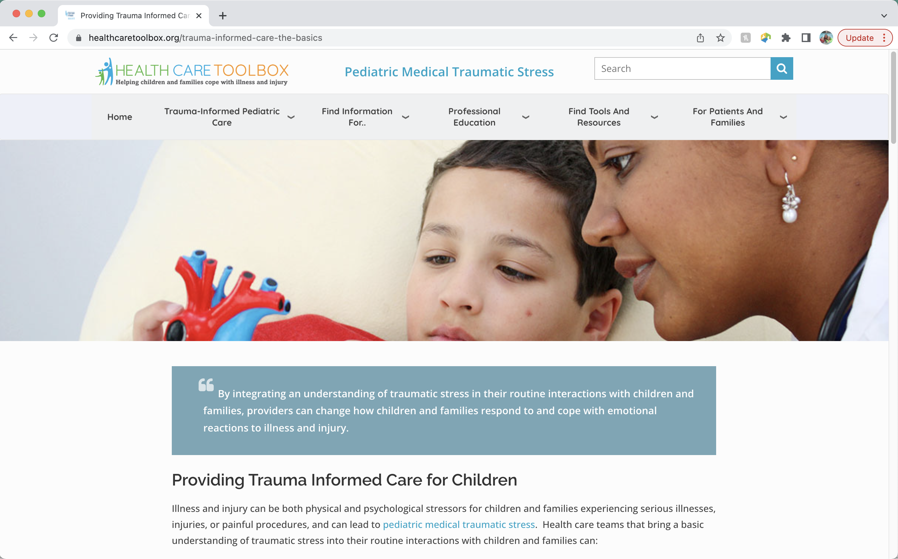

www.HealthCareToolbox.org
Heathcaretoolbox.org
Notes:
HealthCare Toolbox is the website for the Center for Pediatric Traumatic Stress, the sponsor for this project. The Center for Pediatric Traumatic Stress is a member of the National Traumatic Stress Network. The mission of the Center for Pediatric Traumatic Stress is to reduce pediatric medical traumatic stress through promoting trauma-informed healthcare, disseminating evidence-based practices and screening tools to pediatric healthcare providers and training providers to recognize and address traumatic stress in children.

Slide 49
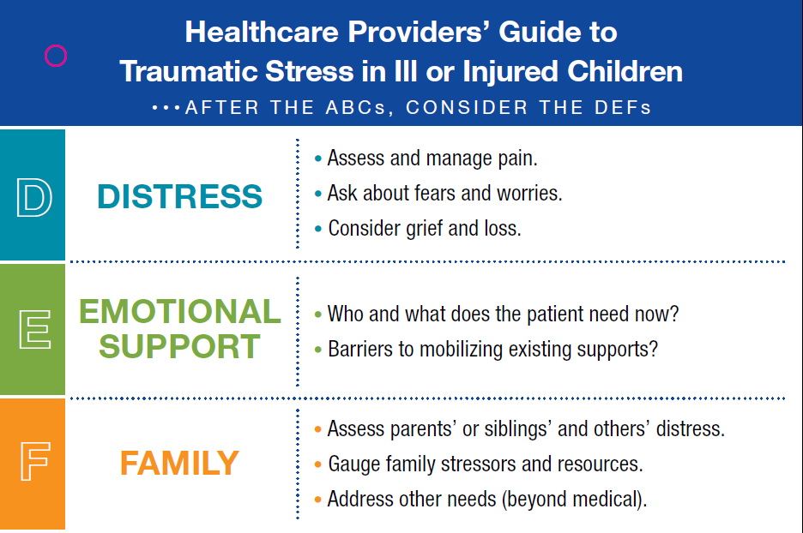
Respond: DEF Protocol
Heathcaretoolbox.org
Notes:
D-E-F is an acronym that is helpful in for healthcare professionals to use when assessing traumatic stress in patients and their families.
D- Distress of the patient
E- Emotional Support needed by the patient
F- Family Needs at this time
www.healthcaretoolbox.org

Slide 50
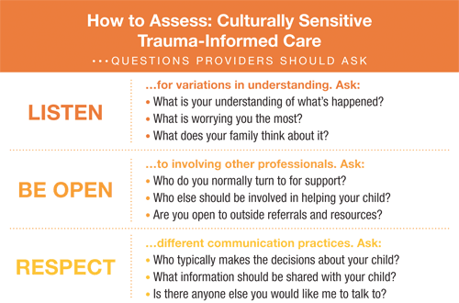
Respond: Considerations in providing Culturally-Sensitive Trauma-Informed Care
Culture includes, but is not limited to:
  Religious beliefs
  Socioeconomic status
  Gender
  Sexual identity
  Literacy level
  Residency
Notes:
View relationships, assessments and treatments through a Culturally-Sensitive Trauma-Informed Lens
Culture is more than race and ethnicity
The capacity for health care professionals to effectually provide trauma-informed assessment and intervention that acknowledges, respects, and integrates patients' and families' cultural values, beliefs, and practices.
As in all pediatric care, Culturally-Sensitive Trauma-Informed Care requires attention to be paid to a child's and family's values and beliefs about health and illness.
- What's unique is that attention must also be paid to cultural variations in the child's and family's experience of and response to trauma.
Research suggests that although there is a universal biological response to trauma, cultural factors can influence the biopsychosocial experience of trauma and subsequent traumatic stress reactions.
Ethno-cultural factors play an important role in an individual's vulnerability to, experience and expression of traumatic stress, as well as their response to trauma treatment.
Culture includes, but is not limited to:
Religious beliefs
Socioeconomic status
Gender
Sexual identity
Literacy level
Residency
Keep in mind the current political and social contexts in which we are living
Culturally-Sensitive Trauma informed care is a great way to incorporate family centered care into your practice and culturally sensitive trauma informed care is based upon listening, being open, and respecting the different cultural practices of everyone that we care for. Recognizing that what some patients need at the time of their treatment may differ from what you or your family would need in that moment. So we want to:
Listen to their understanding of the situation, their worries and thoughts
Be Open to who they want by their side, what kind of help they are seeking
And Respect the ways in which they communicate about what they need at that time.
Ultimately, it is good practice to view all relationships, assessments and treatments through a culturally sensitive trauma informed lens
View RELATIONSHIPS through a Culturally-Sensitive Trauma-Informed lens
Understand your role as a provider within this family's world.
Gain a better understanding of the roles and dynamics within this family.
Consider and facilitate the inclusion of others (extended family, clergy, healers) when treating patients.
View ASSESSMENT through a Culturally-Sensitive Trauma-Informed lens
The manifestation and expression of psychological states differ depending on personal, familial, and cultural beliefs and practices.
Listen to and use the family's own terms during assessment and treatment planning
Trust in / comfort with the provider is vital and it’s up to us to promote trust.
View TREATMENT through a Culturally-Sensitive Trauma-Informed lens
Healing comes in many different forms; your ideas, beliefs, and values may differ from the family's.
Be sure you have integrated the family's understanding of diagnosis, prognosis, and healing into your treatment planning.
Consider each family's resources and barriers to help-seeking and utilization of supportive services within the community.
Resources:
https://healthcaretoolbox.org/cultural-considerations
“How Racism Can Affect Child Development”: https://developingchild.harvard.edu/resources/racism-and-ecd/

Slide 51
Resources
ACEs Connection: http://acesconnection.com
After the Injury: https://www.aftertheinjury.org/
CDC: www.cdc.gov/violenceprevention/acestudy
Center for the Developing Child- Harvard University: https://developingchild.harvard.edu/
International Society for Traumatic Stress Studies (ISTSS): https://istss.org/home
National Child Traumatic Stress Network: https://www.nctsn.org/
Original ACE Study: www.acestudy.org
National Center for PTSD - www.ncptsd.org
Notes:
Resources that are relevant to this information and have been referenced throughout the presentation.

Slide 52


