Slide 1



Incorporating Trauma-Informed Principles
When Eliciting a Pediatric Patient Health History
Notes:
Welcome to “Incorporating Trauma-Informed Principles When Eliciting a Pediatric Patient Health History”. This slide set is a framework for instructors to follow to facilitate in delivery of trauma-informed care education. Helpful information, tips and resources will be available at the bottom of each slide for additional reference.

Slide 2
Learning Objectives
Understand the importance of approaching a patient health history using a trauma-informed perspective with pediatric patients and their caregivers
Identify potential health history elements/questions that might be challenging to obtain from pediatric patients and families
Incorporate trauma-informed principles in to practice of obtaining health history with pediatric patients and their families
Notes:
A clinician's first introduction to a patient is often through a health history and physical exam. This initial interaction can set the tone for how safe the patient feels within this therapeutic relationship. Efforts to create a safe environment through the initial history taking process can help support the development of a trusting patient-provider relationship.
Pediatric patients are a population with specific needs that are different from that of adults. Unique elements such as varying developmental stages in childhood and adolescence and the physical and emotional properties that come with these stages, coupled with their dependence on and the addition of caregivers are important considerations and makes caring for pediatric patients different than caring for adults. It is important to keep in mind that pediatric patients are not simply “little adults”.

Slide 3
Let’s start with a few scenarios we may see in practice:
A child who thinks that undressing means
“getting a needle”
It may be helpful to offer an explanation beforehand (if age appropriate) or have the caregiver do it without the medical provider in the room
An adolescent who does not want a provider
to “see” their body
It may be helpful to offer a drape and as much privacy as possible to only expose necessary areas.
A caregiver who reacts severely to a provider restraining the child for an immunization or ear check
It may be helpful to asking the caregiver for suggestions or to be involved in the process.
Notes:
When thinking about these scenarios and how the patients and caregivers may feel in these situations, this may give you a moment to consider that the reactions that we see may not fit our anticipated reactions. However, when considering the backgrounds or prior traumas that patients and caregivers may have experienced, their reactions may make more sense.

Slide 4
What is “trauma”?
Event
Experience
Effects
“Trauma” = potentially distressing event / experience
“Traumatic stress” = reactions to that experience
Notes:
Many of our patients and their caregivers will enter care with histories of trauma, with some entering care while currently experiencing traumatic events (intimate partner abuse, community violence, child abuse and neglect, etc.). And, regardless of prior experiences, aspects of medical events and treatment can themselves be stressful or potentially traumatic. It is for these reasons that nurses should approach all patient/nurse interactions using a Trauma Informed approach. Importantly, while a traumatic experience can happen to someone, it is not their identity.
It is important to note that nurses may be bringing their own histories of trauma and experiences that may shape the way that they deliver care and how they respond to the experiences that they encounter while in their roles.
References:
Substance Abuse Mental Health Administration (SAMHSA) - https://ncsacw.samhsa.gov/userfiles/files/SAMHSA_Trauma.pdf

Slide 5
Understanding the Impact of Emotional Trauma
Realize
Recognize
Respond
Resist
the widespread impact of trauma and understands potential paths for recovery
signs and symptoms of trauma in patients, families, staff and others involved in the system
by fully integrating knowledge about trauma into their practice, as well as into policies and procedures
Seeks to actively resist re-traumatization
Notes:
The “4R’s” of Trauma Informed Care are assumptions that support a nurse’s Trauma Informed approach to developing, engaging, and maintaining successful patient/nurse interactions.
Nurses innately engage in this type of care. It is through a shared language that this is recognized and enhanced. The overall approach is to recognize that many people in caring professions do this naturally, but don’t necessarily name it as “Trauma Informed Care.” The purpose of this naming this approach is to codify and strengthen these activities and approaches and add to a nurses’ toolbox.
Larger systems or organizations should also consider how the 4R’s frame the way in which services are developed, delivered, and evaluated with and for their patient population. Within the organizational framework, this consideration is also extended to all staff engaged in delivering Trauma Informed Care.
Realizes
In a Trauma Informed approach, there is a basic realization about trauma and an understanding of how trauma can affect individuals, families, groups, organizations, and communities. People’s experiences and behaviors are understood in the context of coping strategies designed to survive adversity and overwhelming circumstances, whether these occurred in the past, whether they are currently happening, or whether they are related to the emotional distress that results in hearing about the firsthand experiences of another. There is an understanding that this trauma plays a role in all systems that a person is involved in and that it should be systematically addressed in prevention, treatment, and recovery settings with the realization that not addressing prior or existing trauma is often a barrier to effective outcomes for patients and their families.
In healthcare we realize that all patients and their families could potentially be afflicted by prior or existing trauma and that it is recommended to approach trauma as more of a universal precaution.
The response to this trauma may be seen through behaviors and reactions in interactions with the healthcare system. It is especially through obtaining a health history where we may first see signs of this trauma and how it impacts the behaviors and actions of patients and families.
Recognizes
Healthcare professionals are charged with the task of recognizing the signs of trauma, but also approaching trauma as a universal precaution. This assists the healthcare team in ensuring that all patients, families, and staff are treated as if they have a trauma history. By caring for all patients and families and collaborating with colleagues as if they have a trauma history, regardless of knowledge of past experiences, enables healthcare professionals to appropriately interact without needing to know the trauma that has been experienced. In the event that patients, families or staff are expressing signs and symptoms associated with trauma, the healthcare professional who is Trauma Informed will recognize these signs and symptoms and proceed appropriately. Workforce development, employee assistance, and supervision practices supports Trauma Informed practices.
Responds
Healthcare providers respond by applying principles of a Trauma Informed approach to all areas of care. A nurse who is Trauma Informed understands that the experience or traumatic events impacts all people involved, whether directly or indirectly and, with their colleagues, responds appropriately. When caring for all patients, especially through actions such as a physical assessment or procedures that may be uncomfortable, it is important that a healthcare providers implement strategies that support Trauma Informed practices. A healthcare system that is trauma informed responds to trauma by fostering an environment in which language, behaviors and policies support the staff through ongoing evidence-based education and training, as well as ensuring that relevant policies are implemented, evaluated, and updated as appropriate.
Resist
A Trauma Informed approach seeks to resist re-traumatization of patients, families, and staff. Because of the nature of the healthcare environment, trauma may be unavoidable, but it is important that the goal of resisting re-traumatization is paramount and that recognition of new trauma that may be experienced is promptly recognized and responded to appropriately. Additionally, some environments and organizations inadvertently support stressful or toxic environments that interfere with the treatment and recovery of patients, families, and staff. Being a Trauma Informed healthcare provider means recognizing how organizational practices and factors may create new trauma, trigger painful memories, and/or retraumatize patients and their families. For example, providers recognize that using restraints on a person who has been sexually abused or placing a child who has been neglected and abandoned in a seclusion room may be re-traumatizing and interfere with healing and recovery.
REF
Substance Abuse Mental Health Administration (SAMHSA) - https://ncsacw.samhsa.gov/userfiles/files/SAMHSA_Trauma.pdf

Slide 6
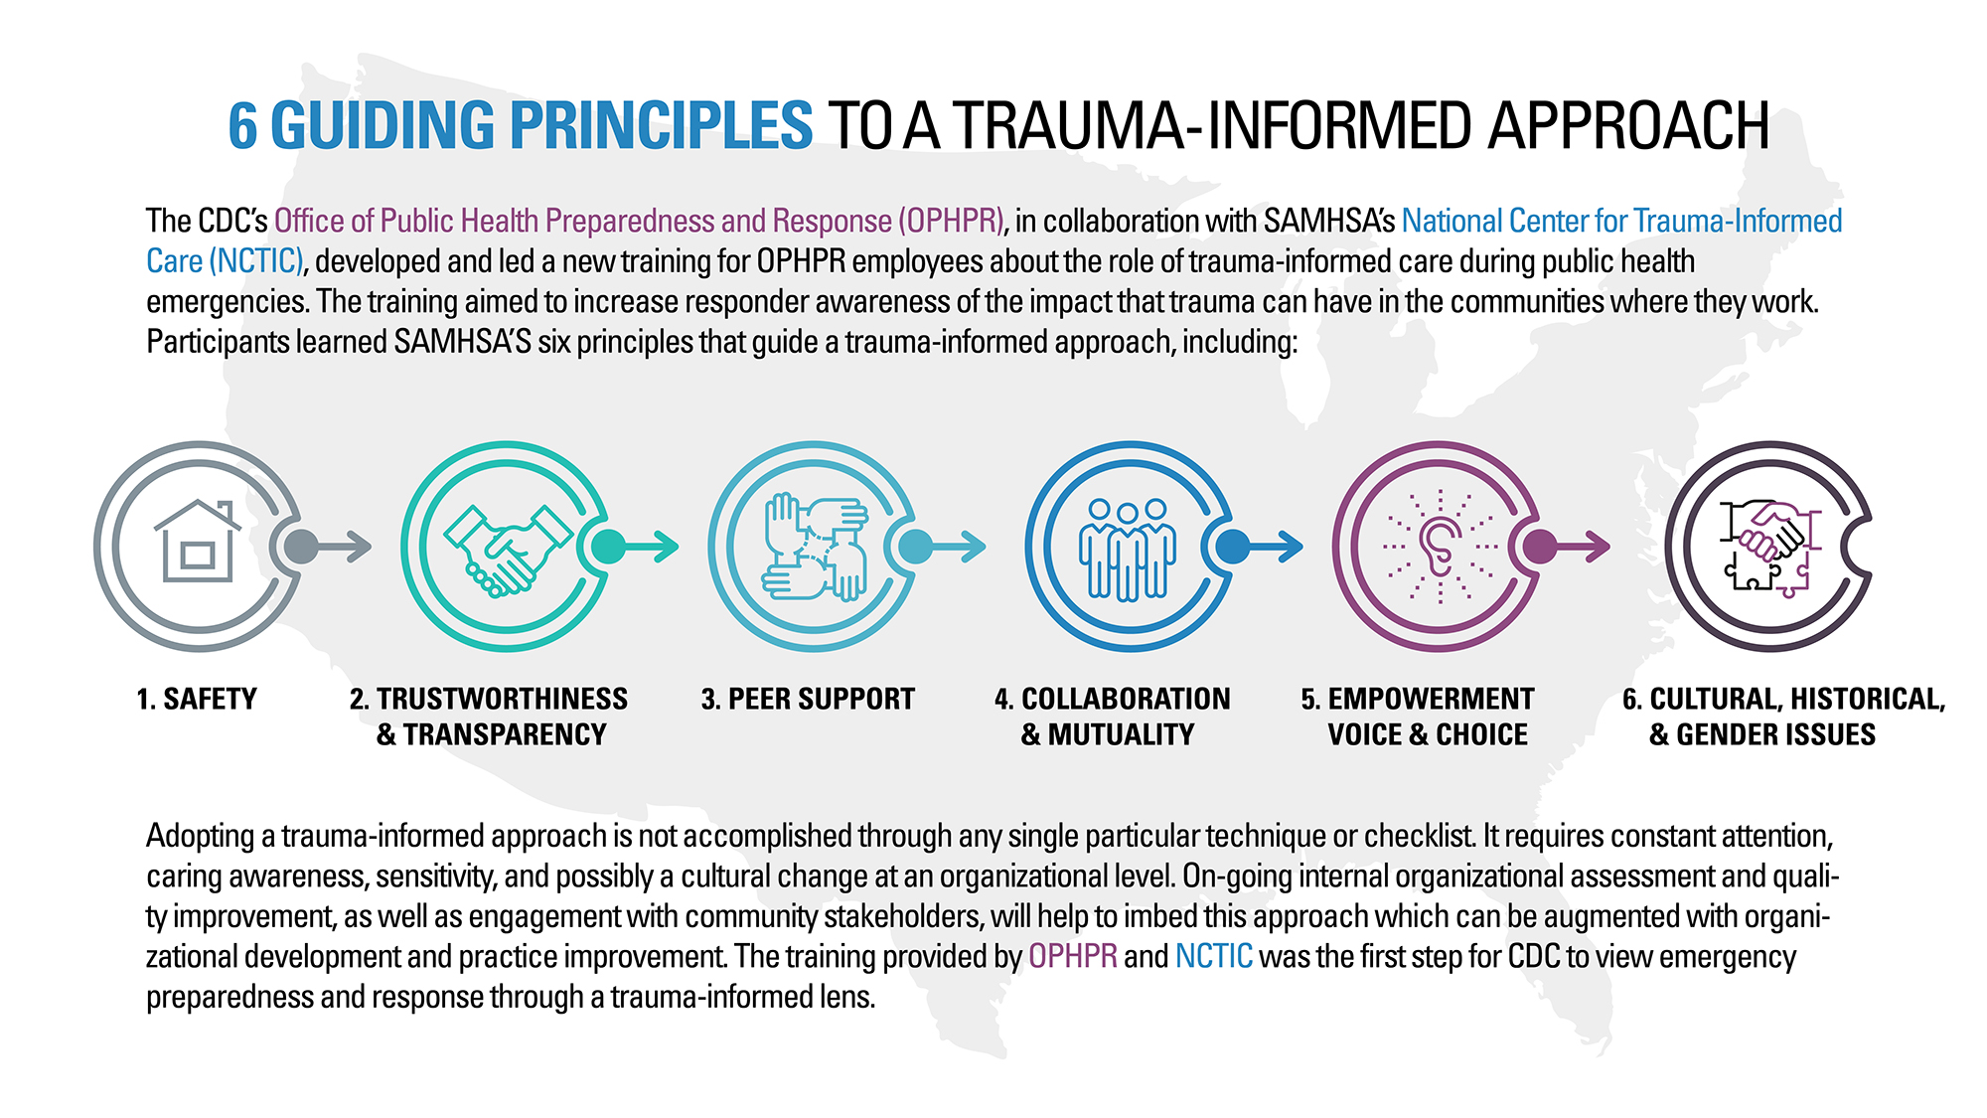
The Six Trauma-informed Principles
https://www.cdc.gov/cpr/infographics/6_principles_trauma_info.htm
Notes:
Nurses should view the Six Trauma Informed Principles as a loose conceptual framework from which nurses’ interactions with patients, families, and peers can be considered, enacted, and evaluated. Thoughtful evaluation of patient/nurse interactions will likely demonstrate that nurses can and do routinely employ multiple Principles concurrently. As nurses consider their interactions with patients in light of the Six Principles, some questions should be posed (examples include):
Are there specific Principles they find easier to apply? More challenging to apply?
Does application depend on individual patient's situation?
Is bias involved?
Are there system wide resources or trainings that could be developed and deployed to help support inclusion of these Principles in a more responsive way?
Are there barriers (time, personnel, space, organizational culture, etc.) to incorporating these Principles that can be addressed?
Safety: For patients and caregivers to feel safe, it is important to recognize that emotional as well as physical safety are necessary while obtaining a health history and/or physical exam. Recognition of ways that providers can facilitate safety for patients and caregivers and taking the actions to facilitate a safe space for exchange of information is paramount.
Trustworthiness and Transparency: To foster trustworthiness and transparency, patients and caregivers must believe and feel that their well-being is paramount for the provider that they are working with within the context of their relationship. They must feel comfortable that their patient/nurse relationship is built on trust and open communication about concerns, needs, and treatment. Transparency and trust are evident through practice and policies.
Peer Support: Peer support and mutual self-help are important ways to foster safety and hope, build trust, and enhance collaboration between patients, providers, and staff. It is important that patients and caregivers recognize that peer support can be helpful should experiences and encounters reintroduce past trauma. Providers must recognize that they also have support available in their peers in their roles.
Collaboration and Mutuality: Nurses should recognize and attempt to reduce real and perceived power imbalances in their encounters with patients and families. Authentic collaboration between patients and providers around treatment plans helps to promote an environment in which there is mutual respect and embraces the strengths that each party brings to the patient/nurse interaction. Patients and families should be viewed as valuable members of the care team who are equipped with the tools to collaborate with providers in the management of their care.
Empowerment, Voice and Choice: A Trauma Informed approach recognizes and builds upon the strengths of patients, caregivers, and providers and ensures that they are empowered to express their choices and use their voices when it comes to their care and treatment. Key elements of empowerment, voice, and choice include supporting patients and caregivers in shared decision-making and active engagement in treatment plans, encouraging and supporting self-advocacy, and ensuring staff are equipped with the tools necessary ensure that these voices and choices are heard.
Cultural, Historical, and Gender Issues: To provide Trauma Informed Care, healthcare organizations and healthcare providers must: 1) actively identify and challenge cultural stereotypes and biases (e.g. based on race, and ethnicity, sexual orientation, age, religion, gender identity, geography, etc.); 2) offer access to gender responsive services; 3) leverage the healing value of traditional cultural connections; 4) incorporate policies, protocols, and processes that are responsive to the racial, ethnic, and cultural needs of individuals served; and 5) recognize and address historical trauma.
REF
Substance Abuse Mental Health Administration (SAMHSA) - https://ncsacw.samhsa.gov/userfiles/files/SAMHSA_Trauma.pdf
Foli, K. J. & Thompson, J. R. (2019). The Influence of Psychological Trauma in Nursing.

Slide 7
Considerations
Pre-Visit Review of Medical History
Introductions
Privacy, Confidentiality, and Safety
Provider Body Language and Use of Physical Self
After the Health History (or Exam)
Documentation
Challenges You May Face
Notes:
This brief review, which focuses specifically on taking a trauma informed health history, is intended to build upon existing foundational knowledge a provider has likely gained through previous study. While some suggestions offered in this review might seem second nature to experienced providers, our goal is to highlight how these suggestions “fit” within the Six Trauma Informed Principles highlighted in Slide 2. These suggestions are not exhaustive but rather, provide a frame of reference for providing Trauma Informed Care in a variety of settings.
*It is important to note that using this Trauma Informed approach does not necessarily equate to taking a trauma history. In some cases, we may not routinely ask about any trauma and instead operate under a “universal precautions” model.

Slide 8
Pre-Visit Review of Medical History

Slide 9
Pre-Visit Review of Medical History and Reason for Visit
Before meeting the patient, providers should review patient’s preferred name, pronouns, past medical history, and reason for the visit (paying specific attention to medical history surrounding this visit) as well as the caregiver’s name and relationship to the patient.
The patient might be referred to by a different name than what is recorded in the medical records.
The patient’s pronouns might differ from what is stated in their medical chart or might not be consistent with cis-gender names.
Notes:
If developmentally appropriate ask the patient, “What do you like to be called?” or refer to caregiver for guidance.
Ask the caregiver how they would like to be addressed. Don’t assume that you should refer to them as “mom” or “dad”.
Depending on the developmental age, it may be appropriate to ask the caregiver which pronouns the child uses.
While some pediatric patients may not have a lengthy health history, it is important that healthcare professionals review any history so that the patient and caregiver feel comfortable with their plan of care.
TIC Principles: Reviewing the patient information prior to meeting with the patient supports a Trauma Informed interaction by allowing the patient to feel like they are working with a provider who is aware of their preferences, history, and reason for visiting. This fosters a sense of safety, supporting trustworthiness & transparency between the patient and caregiver and health care team. It also embraces the principal of empowerment, voice, & choice by encouraging the patient and their caregiver to share their preferences. Reviewing this information also considers any cultural, historical and gender issues that the patient may face.

Slide 10

Pre-Visit Review of Medical History and Reason for Visit
Reviewing the patient’s medical history and reason for visit provides important information that will help the clinical encounter be more efficient and may help patients and caregivers feel the provider is familiar with their previous care.
Avoid assuming the relationship between the patient and caregiver at appointment. Be sure to ask and clarify.
Notes:
If developmentally appropriate ask the patient, “What do you like to be called?” or refer to caregiver for guidance.
Ask the caregiver how they would like to be addressed. Don’t assume that you should refer to them as “mom” or “dad”.
Depending on the developmental age, it may be appropriate to ask the caregiver which pronouns the child uses.
While some pediatric patients may not have a lengthy health history, it is important that healthcare professionals review any history so that the patient and caregiver feel comfortable with their plan of care.
TIC Principles: Reviewing the patient information prior to meeting with the patient supports a Trauma Informed interaction by allowing the patient to feel like they are working with a provider who is aware of their preferences, history, and reason for visiting. This fosters a sense of safety, supporting trustworthiness & transparency between the patient and caregiver and health care team. It also embraces the principal of empowerment, voice, & choice by encouraging the patient and their caregiver to share their preferences. Reviewing this information also considers any cultural, historical and gender issues that the patient may face.

Slide 11
Provider Introduction

Slide 12

Initial introduction and health history should be completed with the patient fully clothed.
Provider Introduction
Notes:
Pediatric patients feel more comfortable in environments that they are familiar with. Since some children need assistance when changing their clothes, it is important to avoid any unnecessary steps to obtain information. When obtaining a health history, it is best if the patient is fully clothed.
TIC Principle: Safety- Allowing the pediatric patient to stay fully clothed during the health history allows for the patient and their caregiver to feel comfortable and safe during the discussion. For those with a trauma history, being disrobed may be uncomfortable or threatening.

Slide 13
Gauge the patient and caregiver’s comfort with communicating with the provider
Provider Introduction
Notes:
Depending on the developmental age of the patients, most communication may be between the caregiver and the provider. It is important for the provider to gauge the comfort of communication with the caregiver by both the patient and the caregiver.
Some pediatric patients may be comfortable waving hello, high fiving or shaking hands with the provider, while others may be wary of a new person entering the room.
Some pediatric patients may have more information to provide to the provider, while others may feel more comfortable deferring to their caregiver to provide information. For example: “I want to learn how it works best for you both. Would it be okay if Johnny answers my questions, and you can help out when needed?”
Some caregivers may have unresolved trauma of their own, fear or distrust of medical providers or the health system. It is important to keep the caregiver’s feelings and concerns in mind when obtaining the health history.
TIC Principle: Gauging the comfort of communication with the health care professional is important to consider for both the patient and caregiver. Through empowerment, voice & choice, the provider supports the patient and caregiver’s ideal and developmentally appropriate communication style and allows them to communicate in a way that feels most comfortable and natural to them.

Slide 14
Depending on the age of the patient and the protocols in place in the practice, determine when caregivers should step outside the room if appropriate.
Provider Introduction
Notes:
Some patients may feel uncomfortable disclosing sensitive information in front of caregivers. Providers should be familiar with relevant state laws and policy of facility regarding interviewing a minor patient without an adult present.
It is important to let caregivers and patients know that this is a normal part of the clinical encounter and not something they are being singled out for because of any “red flags”.
TIC Principle: Empowerment, voice, & choice allows for patients to share their voice. If there are questions that may be more truthfully answered with caregivers outside the room, this should be an option given to the patient. This also encourages transparency and trustworthiness between the patient and provider.

Slide 15
Preferred language of patient and caregiver should be documented. Should interpretation be needed for the clinical encounter, the provider should engage with a professional interpreter or the language line.
Provider Introduction
Notes:
In some instances, the patient may speak English, but the caregiver may not. It is important that communication between provider and caregiver and patient is delivered in preferred languages with the assistance of a professional interpreter if needed.
TIC Principles: Safety; empowerment, voice & choice; Trustworthiness & Transparency; Cultural, historical and gender issues- Allowing patients to be spoken to and speak in their preferred language is crucial for effective healthcare and allows patients and caregivers to understand that their cultural preferences are being respected and that their concerns, needs, and questions will be appropriately addressed without the risk of miscommunication.

Slide 16
Privacy, Confidentiality, and Safety

Slide 17
Providers should ensure that the location in which the health history takes place is as private as possible while also safe. Caregivers should be with the patient at all times.
Privacy, Confidentiality, and Safety
Notes:
Ensure that proper privacy is provided with door or curtain closed.
If the exam “room” consists of a section blocked off by privacy curtains, consider turning the exam table toward the wall so that patients are not exposed when the curtain is opened.
TIC Principle: Safety. During the health history it is important that the conversation takes place in an area in which the patient and caregiver feel comfortable and safe sharing the information needed. Patients and caregivers should feel that the information that they share will only be heard by the provider and not others in the patient care area. This fosters an environment of confidentiality and allows for patients and caregivers to share information regarding their current visit and/or health history which may or may not be traumatic

Slide 18

When possible, try to ensure that the patient and caregiver are in a comfortable, safe position in the patient care area and in the room while the health history is taking place.
Privacy, Confidentiality, and Safety
Notes:
Some children may feel more comfortable sitting on their caregivers’ lap or holding their hand, while others may want to sit by themselves.
Ensure that the environment includes seating for 1-2 caregivers as well as the patient.
TIC Principles: Safety, trustworthiness, & transparency, empowerment, voice, & choice- Maintaining an environment in which patients and caregivers have a safe, comfortable place to sit during their visit is important. With pediatric patients, it is important that the environment in which the patient and their caregiver are waiting are safe and free from health hazards. Additionally, offering ample seating and choices allows for patients and caregivers to assume a position that makes them feel most empowered to voice their concerns and share the information necessary.

Slide 19
Providers should identify to patient and caregiver what, if any, information they are required to report to outside agencies or authorities (e.g., suspected child abuse or neglect, weapons possession, substance abuse, suicidal or homicidal ideation, etc.)
Privacy, Confidentiality, and Safety
Notes:
The patient or caregiver may share information that makes you concerned about the safety of the patient. It is important to disclose this information when appropriate prior to discharging the patient from your care.
Understanding what information might be reported to external agencies can help the patient/caregiver decide what information they wish to share.
TIC Principles: Safety, trustworthiness, & transparency, Empowerment, voice, & choice – This allows patients and caregivers to understand that this is a place of safety and that certain protocols are in place to keep the patient and their caregiver as safe as possible. By being transparent about what may be happening or has happened in the past that may or may not be traumatic to the individual, the patient and caregiver have the opportunity to choose what information they want to share and understand how the provider can help keep them as safe as possible. At the same time, the provider is being transparent that there are some things that they are required to report to ensure the safety of all.

Slide 20
Providers should acknowledge upfront that some health history questions might be of a sensitive nature (e.g., sexual health, mental health, substance use, etc.).
Privacy, Confidentiality, and Safety
Notes:
This may be the first-time patients and caregivers are asked these questions, so it is important to let them know that these questions are routine and asked of all patients at this developmental stage.
Give patients and caregivers the opportunity to ask for clarification, decline to answer, delay answer and/or clarify previous questions/answers where appropriate.
TIC Principles: Safety; Trustworthiness and transparency; Peer support & mutual self-help—With pediatric patients and their caregivers, there may be some questions that are of a sensitive nature and this may be the first time that the patient/caregiver is being asked these questions. It is important to keep in mind that the patient and caregiver may have a history of trauma associated with the questions asked and that the patient/caregiver are reminded that they are in a safe place and that they can answer these questions honestly and openly to ensure that all health concerns are addressed.

Slide 21
Provider Body Language and Use of Physical Self

Slide 22
Speak clearly and calmly at an acceptable volume.
Provider Body Language and Use of Physical Self
Notes:
Use simple, clinical language.
Be clear in requests or instructions if an exam is necessary.
TIC Principles: Safety; Trustworthiness & Transparency; - Communication with patients and caregivers is an opportunity to foster a safe and trustworthy environment. It is important to speak at a volume and rate that allows patients and caregivers to feel comfortable and aware of what is taking place.

Slide 23

Sit/stand/kneel at eye level with patient.
Provider Body Language and Use of Physical Self
Notes:
Sitting at eye level helps to avoid an imbalance of power or replicate feelings of being deferential to an authority figure.
*It is important to note, some cultures may not want the nurse at “eye level” so while this is a common practice, we should be aware*
TIC Principles: Safety; Trustworthiness & Transparency; - Meeting the patient at their eye level creates an environment in which the patient and caregiver do not feel that the provider is in a position of power. This allows patients and caregivers to understand that they and the provider are on the same level and that the patient is safe.

Slide 24
Always attempt to stay in the patient’s sight.
Provider Body Language and Use of Physical Self
Notes:
When possible, avoid standing or asking questions out of the patient’s view.
TIC Principles: Safety, trustworthiness & transparency – Keeping in the patient and caregivers view allows the patient to be able to see what the provider is doing. It is important that the patient and caregiver are able to anticipate what is going to happen next and that they do not feel surprised. This creates an environment that feels safe and that the provider can be trusted.

Slide 25
Be efficient.
Provider Body Language and Use of Physical Self
Notes:
Pediatric patients are different from adult patients in that they are not likely to sit still for long periods of time. Caregivers will likely be multitasking and will appreciate an efficient health history.
If an exam is required, work from least invasive to most invasive assessment.
TIC Principle: Safety- For those with a trauma history, it is important to be as efficient as possible for the health history and exam (if needed). Since being in a medical environment can be traumatizing, working as efficiently as possible to limit the distress of the patient and caregiver is priority. That being said, it is also important to gauge the comfort of the patient and caregiver and ensure that proper time and attention is give where needed.

Slide 26
Avoid sudden movements.
Provider Body Language and Use of Physical Self
Notes:
Explain to patients what you are going to do before you do it as well as why you are doing it.
Ask patient’s (if developmentally appropriate) or caregiver’s permission before performing any physical exam elements.
TIC Principles: Safety, trustworthiness, & transparency- Always explain to the patient/caregiver what you are going to do before you do it and ask the patient/caregiver’s permission before touching the patient so that they are not surprised and can feel safe, a sense of transparency, and trust in the provider’s care.

Slide 27
Pay attention to patient’s and caregiver’s body language.
Provider Body Language and Use of Physical Self
Notes:
Take note of how the patient appears as you are obtaining their health history: anxious, tense, nervous, distracted, hyper-focused.
Caregiver’s history of trauma may cause concern during the health history or exam, nurses should be mindful of changes in body language and other relational shifts that occur when conducting a health history.
Take clues from the patient or caregiver regarding eye contact. If they are avoiding eye contact, it is not necessarily rude. Looking someone in the eye could be threatening for some people.
TIC Principles: Safety; Empowerment, voice, & choice- Recognizing when the patient/caregiver does not appear comfortable and inviting them to tell you when they no longer feel comfortable creates an environment that supports safety, empowerment, and voice.. For individuals with a trauma history, this is particularly important as they might have experiences where their voice or choice were not respected.

Slide 28
Respect personal space.
Provider Body Language and Use of Physical Self
Notes:
Only touch when necessary and for a clinical purpose (e.g., avoid placing your hand on the patient’s shoulder when performing an eye examination).
Avoid sitting on a patient’s bed while taking a patient’s history or conducting a physical examination.
TIC Principles: Safety; Trustworthiness & transparency; Collaboration & mutuality—Patients/caregivers with a trauma history may not be comfortable being in close proximity with strangers and may be traumatized by the touch of others. It is important that providers only touch the patient when necessary and that clinical professionalism is maintained at all times.

Slide 29
Give choices when possible.
Provider Body Language and Use of Physical Self
Notes:
When working with pediatric patients, it may be appropriate to give them choices when possible. For example, on physical exam asking the child which ear they want you to examine first; or asking if they want to start with the mouth or ears first may help them feel involved in the assessment.
Another way in which a choice may be given and respected is through the presence of another provider, including students, residents, etc. It is important that if someone other than the primary provider is present in the appointment or interaction that they are introduced and the patient and caregiver are asked if it is okay that they are present and take part in the interaction.
TIC Principle: Empowerment, voice, and choice- Allowing patients and caregivers to have a voice or choice in which will happen next allows them to feel a sense of control over what is about to happen. It empowers them with the understanding that if something is happening that they feel uncomfortable with, that they have an opportunity to speak up.

Slide 30
Keep current medical traumatic stress in mind during discussion regardless of prior trauma
Provider Body Language and Use of Physical Self
Notes:
In some instances, a patient or caregiver may have no history of trauma, but the current medical event for which they are meeting with the provider may be experienced as traumatic. It is important to have awareness that patients and caregivers may be worried or distressed about the current medical event or situation. They might also be concerned about receiving test or exam results or worried about what the next steps in their care might be.
TIC Principles: Trustworthiness & transparency helps patients and caregivers to feel that their provider is a trusted party that recognizes that new trauma may come from the current clinical encounter and that they can be transparent when there is discomfort both physically and emotionally.

Slide 31
Help patients and caregivers manage physical discomfort as much as possible.
Provider Body Language and Use of Physical Self
Notes:
Some aspects of the job of medical provider unfortunately cause physical discomfort for patients. It is important for providers to not only recognize and acknowledge to their patients that some actions or procedures that are performed may cause discomfort, but also to work with patients and caregivers to minimize and manage that discomfort as much as possible.
TIC Principles: Empowerment, voice, and choice supports patients and caregivers in the job of speaking for themselves and advocating when they feel that they or their loved one is uncomfortable. Collaboration and mutuality can be seen when patients and caregivers collaborate with the provider to complete necessary but painful or uncomfortable parts of a clinical encounter. Providing anticipatory guidance, including truthfully informing a patient about what they might experience in terms of discomfort during a procedure, is part of informed consent. Encouraging the patient to voice when/if the discomfort (physical or mental) is too much, such as telling the provider to “stop” or “slow down” – and the provider following the patient’s instructions--- is a critical part of Trauma Informed Care.

Slide 32
After the Health History or Exam

Slide 33
If the patient was required to undress for the exam, ensure that they re-dress.
After the Health History or Exam
Notes:
TIC Principle: Safety- Ensuring that the pediatric patient is fully clothed as much as possible during the encounter allows for the patient and their caregiver to feel comfortable and safe during the discussion. For those with a trauma history, being disrobed may be uncomfortable or threatening.

Slide 34
Discuss any results you can with the patient/caregiver and offer reassurance when possible.
After the Health History or Exam
Notes:
Patients and caregivers are typically visiting the healthcare provider because they are concerned about something. If at any time you can provide them with realistic reassurance, you should.
TIC Principle: Trustworthiness & transparency- Some pediatric patients/caregivers may be distressed over their current visit and may be developing trauma or have a history of trauma related to the visit or the medical symptoms. If the provider is truthfully able to offer reassurance based on the results of the health history or exam, they should share this information to help decrease distress and/or trauma.

Slide 35

Explain next steps.
After the Health History or Exam
Notes:
Be clear and literal when outlining the next steps for the patient as well as the caregiver, ensuring that health literacy is considered and that all follow up steps will be provided in writing.
TIC Principle: Empowerment, voice & choice- For some patients/caregivers anticipation of what will happen next in their clinical encounter can be distressing and traumatic. It is important to share the next steps so that patients/caregivers can make choices where possible, share concerns, ask questions, and prepare for what is to come.

Slide 36
Ask: “What questions do you have?” to both patient and caregiver.
After the Health History or Exam
Notes:
In an interaction with pediatric patients and caregivers, pediatric patients may feel that they are not entitled to ask questions. Pediatric patients may misunderstand certain discussions between provider and caregiver. This is a great opportunity to clarify any confusion or misinformation.
TIC Principles: Safety; Trustworthiness & Transparency; Empowerment, voice, & choice—This fosters a sense of open dialogue, safety, and the opportunity for patients/caregivers to share any concerns, questions, and/or clarifications that they have.

Slide 37
Documentation

Slide 38

Prioritize connection with patient/caregiver over typing.
Documentation
Notes:
Suggestions:
Prioritize connection (non-verbal ques) over typing. Examples would be eye-contact if appropriate, sitting down, meeting patient at their level, etc.
Ask if the child/caregiver would like you to speak out loud what you may be typing, for impression or overall assessment
When listening to answers to very personal or sensitive questions, give them your full attention. Documentation may be resumed at a later point during or after the encounter.
TIC Principle: Trustworthiness & transparency - Connecting with the patient/caregiver allows for a professional patient/nurse relationship in which the patient/caregiver has the opportunity to be transparent with the provider and establishes a trusting environment. Additionally, cultural, historical and gender issues should be kept in mind since not all cultures communicate non-verbally in the same way.

Slide 39
Challenges you might face

Slide 40
Working with pediatric patients requires you to work with both patients and their caregivers. It is important to keep the needs and concerns of both in mind while obtaining a health history.
Challenges you might face
Notes:
Some caregivers of pediatric patients may have a trauma history that they bring to the encounter with them, either surrounding the patient’s history or their own. It is important to keep both the patient and caregiver’s needs and concerns in mind while performing a trauma-informed health history.
TIC Principle: Safety- Working with pediatric patients is different than working with adult patients. While the pediatric patient themselves may have a history of trauma, their caregiver may also have a history of trauma that can impact the experience of the clinical encounter of both the patient and the caregiver.

Slide 41

Provider’s own personal factors (prior trauma, parent themselves, scenario that reminds them of something personal) may impact efforts.
Challenges you might face
Notes:
Caring for individuals who have experienced trauma might bring up a provider’s own experience with past or current trauma. It is important to recognize how this might influence care delivery as well as an individuals’ own well-being.
TIC Principles: Safety, trustworthiness & transparency; Peer support – It is important that the providers’ psychological safety is recognized in difficult interactions. The providers’ realization and recognition that they are in a safe environment and are supported by peers is important. Establishing trustworthiness & transparency within the care team helps to foster the practice of making peers aware when a provider may need additional resources or help and reduce stigma associated with asking for support.

Slide 42
Resist: Potential for new trauma/ re-traumatization
Our #1 goal…
is to minimize potentially traumatic aspects of care and reduce the chances that we will re-traumatize patients and families while in our care.
.
Notes:
When patients and families are being cared for, sometimes uncomfortable and even painful experiences may be required during their care. It is the goal of healthcare professionals to limit and minimize the amount of discomfort that is experienced while performing medical care.

Slide 43
Summary of major points
A clinician's first introduction to a patient is often through a health history and physical exam. This initial interaction can set the tone for how safe the patient feels within this therapeutic relationship.
Efforts to create a safe environment through the initial history taking process can help support the development of a trusting patient-provider relationship.
Pediatric patients are a population with specific needs that are different from that of adults and it is important to keep in mind that pediatric patients are not simply “little adults”.

Slide 44
Additional Resources

Slide 45
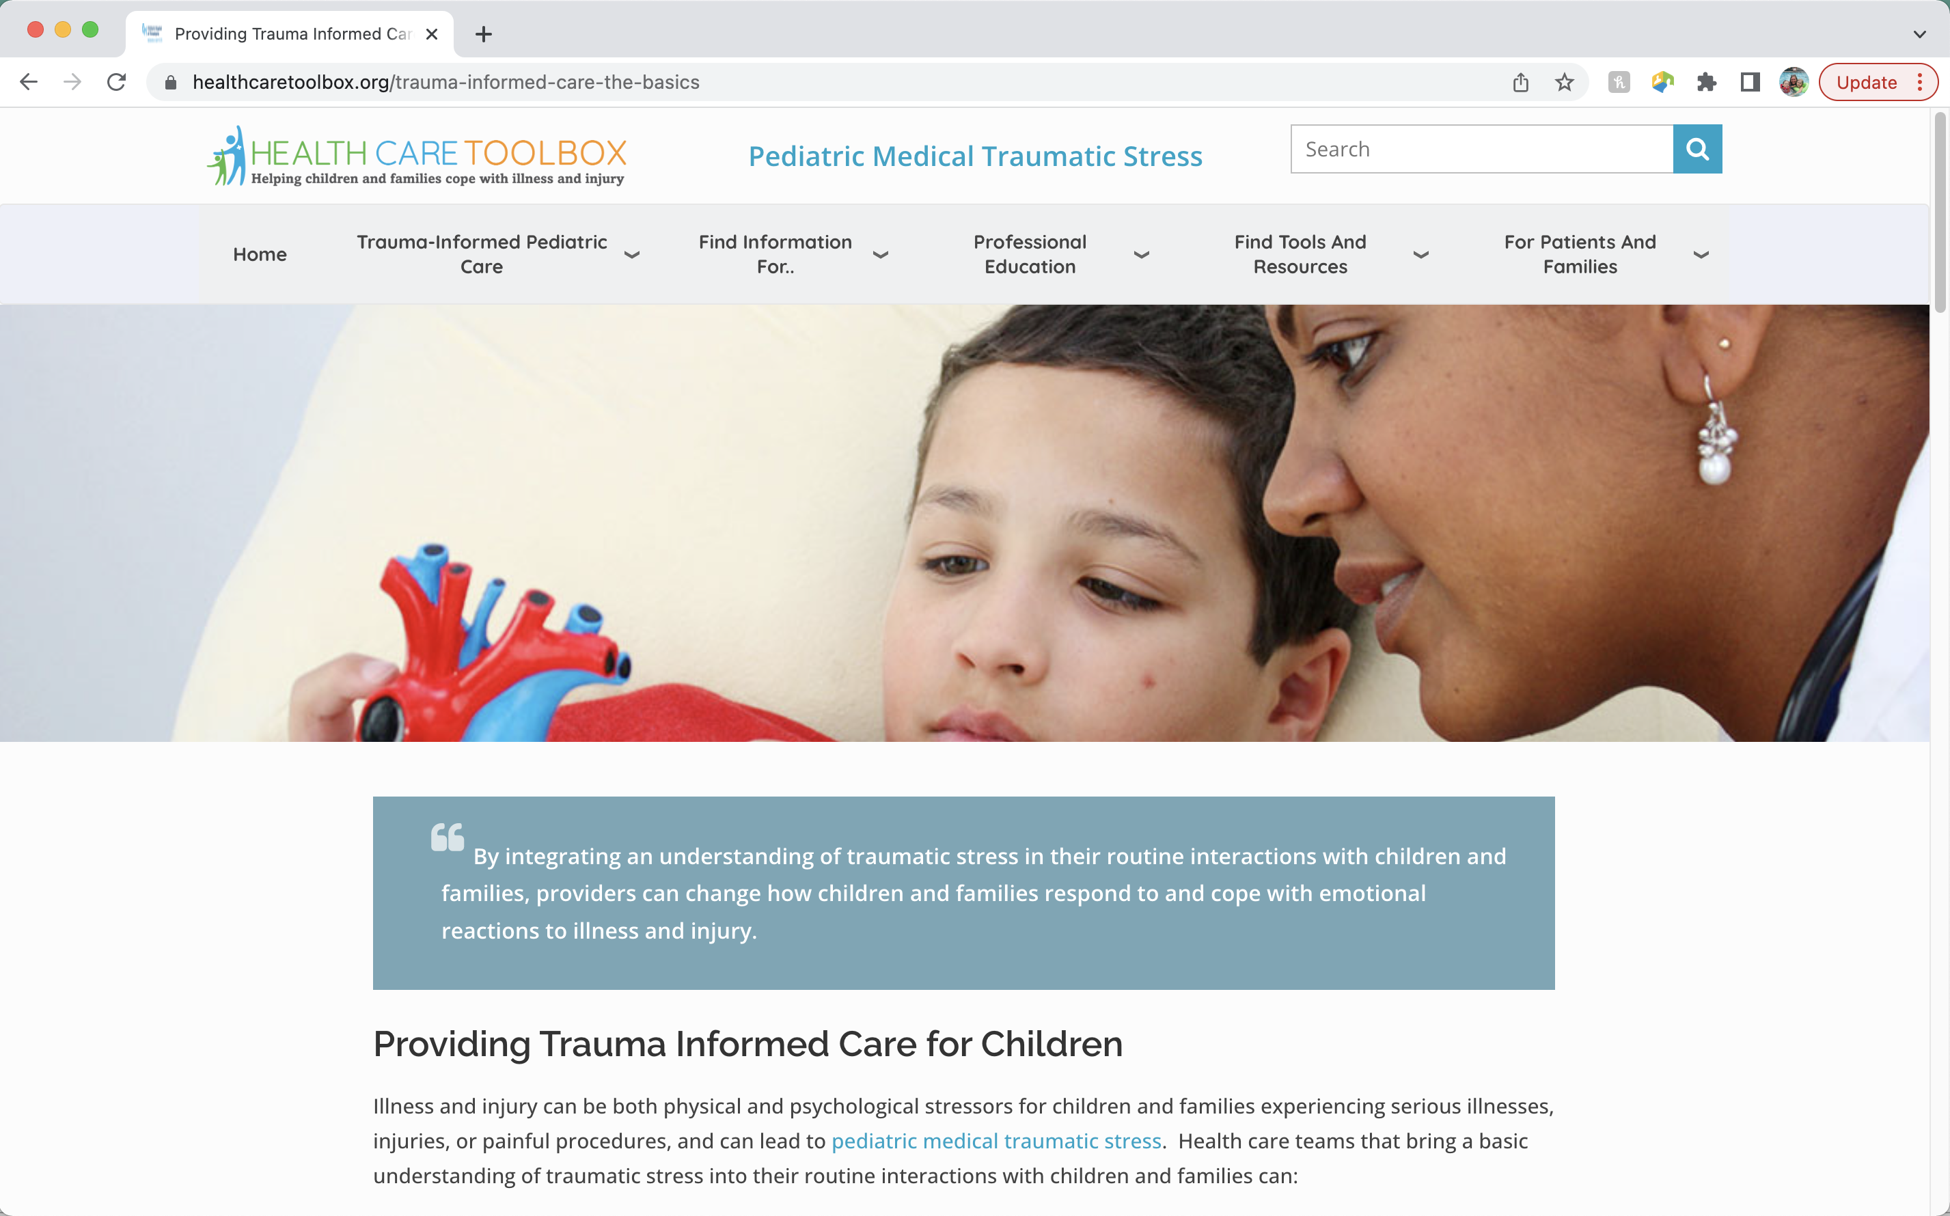

www.HealthCareToolbox.org
Heathcaretoolbox.org
Notes:
HealthCare Toolbox is the website for the Center for Pediatric Traumatic Stress, the sponsor for this project. The Center for Pediatric Traumatic Stress is a member of the National Traumatic Stress Network. The mission of the Center for Pediatric Traumatic Stress is to reduce pediatric medical traumatic stress through promoting trauma-informed healthcare, disseminating evidence-based practices and screening tools to pediatric healthcare providers and training providers to recognize and address traumatic stress in children.

Slide 46
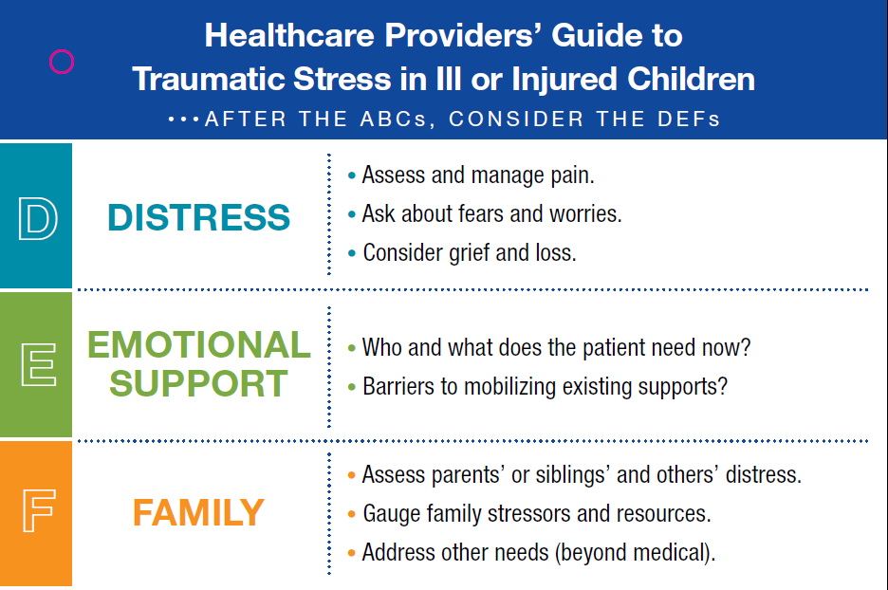
Respond: DEF Protocol
Heathcaretoolbox.org
Notes:
D-E-F is an acronym that is helpful in for healthcare professionals to use when assessing traumatic stress in patients and their families.
D- Distress of the patient
E- Emotional Support needed by the patient
F- Family Needs at this time
www.healthcaretoolbox.org

Slide 47
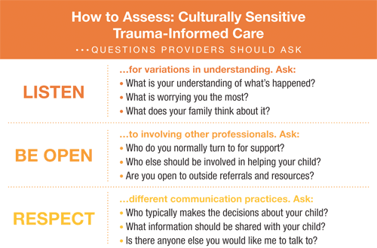
Respond: Considerations in providing Culturally-Sensitive Trauma-Informed Care
Culture includes, but is not limited to:
  Religious beliefs
  Socioeconomic status
  Gender
  Sexual identity
  Literacy level
  Residency
Notes:
View relationships, assessments and treatments through a Culturally-Sensitive Trauma-Informed Lens
Culture is more than race and ethnicity
The capacity for health care professionals to effectually provide trauma-informed assessment and intervention that acknowledges, respects, and integrates patients' and families' cultural values, beliefs, and practices.
As in all pediatric care, Culturally-Sensitive Trauma-Informed Care requires attention to be paid to a child's and family's values and beliefs about health and illness.
- What's unique is that attention must also be paid to cultural variations in the child's and family's experience of and response to trauma.
Research suggests that although there is a universal biological response to trauma, cultural factors can influence the biopsychosocial experience of trauma and subsequent traumatic stress reactions.
Ethno-cultural factors play an important role in an individual's vulnerability to, experience and expression of traumatic stress, as well as their response to trauma treatment.
Culture includes, but is not limited to:
Religious beliefs
Socioeconomic status
Gender
Sexual identity
Literacy level
Residency
Keep in mind the current political and social contexts in which we are living
Culturally-Sensitive Trauma informed care is a great way to incorporate family centered care into your practice and culturally sensitive trauma informed care is based upon listening, being open, and respecting the different cultural practices of everyone that we care for. Recognizing that what some patients need at the time of their treatment may differ from what you or your family would need in that moment. So we want to:
Listen to their understanding of the situation, their worries and thoughts
Be Open to who they want by their side, what kind of help they are seeking
And Respect the ways in which they communicate about what they need at that time.
Ultimately, it is good practice to view all relationships, assessments and treatments through a culturally sensitive trauma informed lens
View RELATIONSHIPS through a Culturally-Sensitive Trauma-Informed lens
Understand your role as a provider within this family's world.
Gain a better understanding of the roles and dynamics within this family.
Consider and facilitate the inclusion of others (extended family, clergy, healers) when treating patients.
View ASSESSMENT through a Culturally-Sensitive Trauma-Informed lens
The manifestation and expression of psychological states differ depending on personal, familial, and cultural beliefs and practices.
Listen to and use the family's own terms during assessment and treatment planning
Trust in / comfort with the provider is vital and it’s up to us to promote trust.
View TREATMENT through a Culturally-Sensitive Trauma-Informed lens
Healing comes in many different forms; your ideas, beliefs, and values may differ from the family's.
Be sure you have integrated the family's understanding of diagnosis, prognosis, and healing into your treatment planning.
Consider each family's resources and barriers to help-seeking and utilization of supportive services within the community.
Resources:
https://healthcaretoolbox.org/cultural-considerations
“How Racism Can Affect Child Development”: https://developingchild.harvard.edu/resources/racism-and-ecd/

Slide 48
Resources
ACEs Connection: http://acesconnection.com
After the Injury: https://www.aftertheinjury.org/
CDC: www.cdc.gov/violenceprevention/acestudy
Center for the Developing Child- Harvard University: https://developingchild.harvard.edu/
International Society for Traumatic Stress Studies (ISTSS): https://istss.org/home
National Child Traumatic Stress Network: https://www.nctsn.org/
Original ACE Study: www.acestudy.org
National Center for PTSD - www.ncptsd.org
Notes:
Resources that are relevant to this information and have been referenced throughout the presentation.

Slide 49


