Slide 1



Introduction to
Trauma-Informed Care
Notes:
Welcome to “Introduction to Trauma-Informed Care”. This slide set is a framework for instructors to follow to facilitate in delivery of trauma-informed care education. Helpful information, tips and resources will be available at the bottom of each slide for additional reference.

Slide 2
Overview
What is Trauma?
The 4-R’s of A Trauma-Informed Approach
Additional Resources

Slide 3
What is “trauma”?
Event
Experience
Effects
“Trauma” = potentially distressing event / experience
“Traumatic stress” = reactions to that experience
Notes:
According to the Substance Abuse Mental Health Services Administration (SAMHSA) “trauma” results from an event, series of events or set of circumstances that is experienced by an individual as physically or emotionally harmful or life-threatening and that has lasting adverse effects on the individual’s functioning and mental, physical, social, emotional or spiritual well-being.
“Trauma” is referred to as a potentially distressing event or experience and “traumatic stress” are reactions to that experience.

Slide 4
Understanding the Impact of Emotional Trauma
Realize
Recognize
Respond
Resist
Notes:
Substance Abuse Mental Health Services Administration Trauma-Informed Approach: The 4 R’s
Realization about trauma and how it can affect people and groups
Recognizing the signs of trauma,
Have a system which can Respond to trauma
and ultimately Resist re-traumatization
Resource: https://ncsacw.samhsa.gov/userfiles/files/SAMHSA_Trauma.pdf

Slide 5
Realize: the widespread impact of trauma and understanding potential paths for recovery
Notes:
Realize: The widespread impact of trauma and understanding potential paths for recovery

Slide 6
Realize: Developing A Shared Language: “Trauma”
Medical Trauma
Acute/Single Event
Allostatic Load
Attachment Related
War Trauma
Complex
Chronic Toxic Stress
System Induced
Relational
Situational
Unprocessed Memories
Vicarious Trauma/ Secondary Traumatic Stress/Compassion fatigue
Lakeside Global Institutes, Enhancing Trauma Awareness
Formed Families Forward Trauma Sensitive Approaches for Home and School: Video 1
Notes:
It is important to share that there are many different types of "trauma". Here are some types of trauma with examples that may be relatable.
Medical Trauma – Illness, injury; procedures, isolation, ongoing medical care, related to illness or injury
Acute/Single Event – one-time traumatic event
Allostatic Load – physiological impact and emotional weight of chronic/toxic stress
Attachment Related – experience of insecure attachments early in life
Chronic – repeated experiences
Complex – repeat experiences of different kinds of trauma; relational; chaos and unpredictability
Chronic Toxic Stress – Ongoing extreme stress
System Induced – unintentionally caused by service systems such as medical systems; law enforcement and justice system, foster and residential care, the courts; schools,
Relational – interpersonal; someone known trustworthy, power
Situational – events not perpetrated by others (car accidents, terrorist attacks, natural disasters
Unprocessed Memories – not considered traumatic but child creates powerful toxic beliefs about an experience then haunts person as an adult
Vicarious Trauma, Secondary Traumatic Stress, compassion fatigue – hearing about or witnessing someone else’s trauma; acquired through direct or indirect experience
War Trauma – physical trauma coupled with terror of extreme danger witnessing trauma incurred by others

Slide 7
Realize: Enhancing our Trauma Language
Cultural/Political
Historical Trauma
Intergenerational Trauma
Lakeside Global Institutes, Enhancing Trauma Awareness
Notes:
Cultural/Political – cultural practices and/or political unrest, revolutions, coups
Historical Trauma – trauma that impacts whole communities; legacy of slavery, holocaust, colonialism, racism
Intergenerational Trauma– passed to down one generation to the next; often exacerbated by family loyalty, beliefs, and behaviors
“In addition to terrifying events such as violence and assault there are additional types of trauma. In today’s world, we are no strangers to cultural and political trauma and this is where we see Racism, Discrimination, Oppression, Poverty ––– when experienced chronically, have a cumulative impact that can be fundamentally life-altering." -Lakeside Global Institute
Trauma that impacts whole communities is categorized as historical trauma and can continue for many generations.
And that’s where we have intergenerational trauma and this is passed down from one generation to the next- here we can see how family stereotypes, beliefs and behaviors can continue to impact families generation after generation. One of the first articles to note the presence of intergenerational trauma appeared in 1966, when Canadian psychiatrist Vivian M. Rakoff, MD, and colleagues documented high rates of psychological distress among children of Holocaust survivors (Canada’s Mental Health, Vol. 14). Since then, researchers have been assessing anxiety, depression and PTSD in trauma survivors and their progeny, with Holocaust survivors and their children the most widely studied and over the longest period of time.
Resource: Lakeside Global Institutes
DeAngelis, T. (2019, February). The legacy of trauma. Monitor on Psychology, 50(2). http://www.apa.org/monitor/2019/02/legacy-trauma

Slide 8
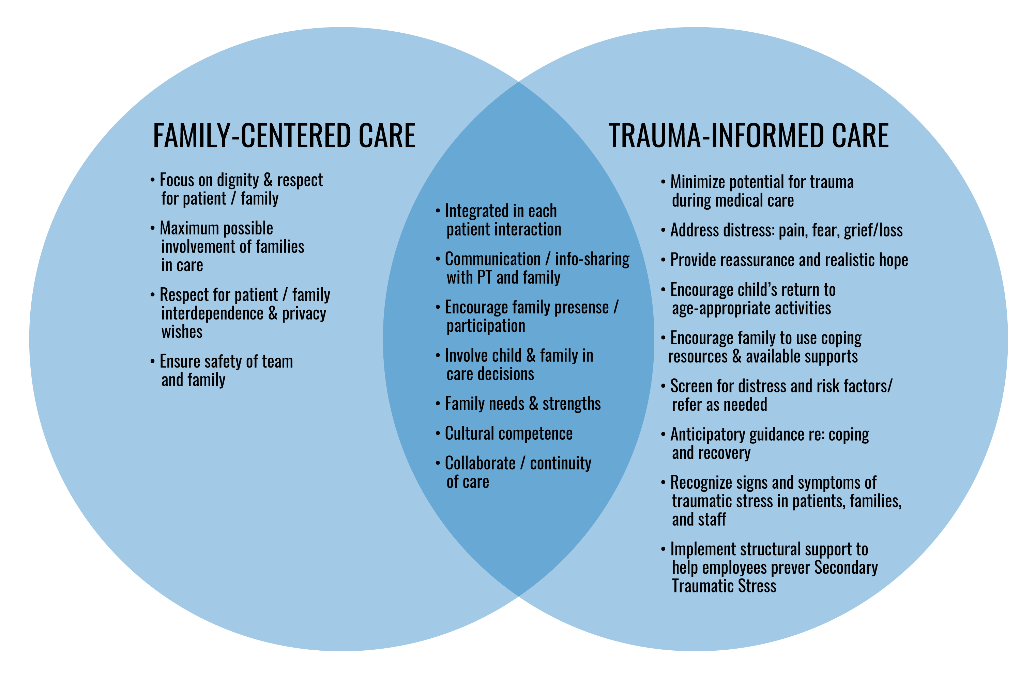
Realize: Family-Centered Care and Trauma-Informed Care
Notes:
Family-centered care, a model that many are familiar with is complimentary to trauma-informed care. Family-centered care and trauma-informed care are two distinct approaches but there is a lot overlap. They’re compatible and are easily implemented in that same space. Together they contribute to more fully enhance the patient family experience. You can see, in the TIC circle that recognizing and understanding Secondary Traumatic Stress is a key feature to TIC.

Slide 9
Realize: The Role of Stress
Stress is a natural and necessary part of development. The type of stress we experience and the context in which we experience stress determines the impact.
Positive Stress
Tolerable Stress
Toxic Stress
Mild elevated stress response – a healthy response to situations we deem as uncomfortable or bring a sense of tension. May bring brief increases in heart rate.
Temporary stress responses that is typically time limited, which allows for healing. More intense physiological responses (cardiovascular, immune).
Prolonged, chronic, and unpredictable activation of our stress system; difficult to return to state of calm. Disruption in brain architecture, likelihood of illness increases.
Description
First Day of School
Expected death of older relatives
Abuse or neglect, unable to meet basic needs
Example
Occurs with limited to no external supports. This stress can be motivating.
Likely to occur in the context of relationships. Prior coping skills can be called upon.
Inhibited by lack of buffering supports, who may be enduring toxic stress. Individual is too overwhelmed to use supports.
Adaptation
NOTE: these are examples of types of exposure that fit into each type of stress. Every individual CONTEXT and PERCEPTIONS are unique. Our prior and current experiences also influence how we perceive exposures to stress.
Notes:
Positive- good stress. Stress related to presentation or an exciting milestone in life.
Tolerable- Serious but temporary and it has the ability to be buffered by supportive relationships. This is the stress that we can’t avoid, but we can support after they happen.
Toxic- prolonged activation of stress- never-ending and the lack of those supportive relationships. Grizzly bear- who lives in your house.

Slide 10
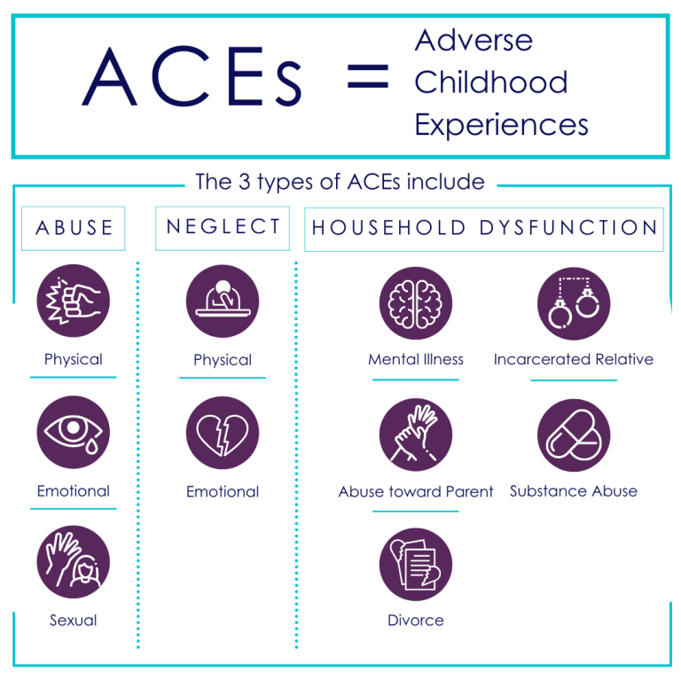
Realize: Adverse Childhood Experiences Study (ACES)
https://advokids.org/adverse-childhood-experience-study-aces/
Notes:
ACES and trauma are related – but not the same.
Adverse Childhood Experiences or ACES come from a Kaiser Permanente Study done that took place between 1995 and 1997 with two waves of data collection. Over 17,000 Health Maintenance Organization members from Southern California receiving physical exams completed confidential surveys regarding their childhood experiences and current health status and behaviors.
ACES are broken down into 3 categories: Abuse/neglect/household dysfunction and included:
Physical, emotional and sexual abuse; physical and emotional neglect; and exposure to mental illness, abuse toward parent, incarcerated relative, substance abuse, or divorce in their home life.
Findings: Almost two-thirds of study participants reported at least one ACE, and more than one in five reported three or more ACEs.
There have been more studies completed since then looking into ACEs.
For example: Philadelphia ACE study (2012)
37% of Philadelphians reported 4 or more ACEs
ACES Videos:
Nadine Burke Harris TED Talk: https://www.ted.com/talks/nadine_burke_harris_how_childhood_trauma_affects_health_across_a_lifetime?language=en
ACES and Toxic Stress: https://developingchild.harvard.edu/resources/aces-and-toxic-stress-frequently-asked-questions/
Resources:
Advokids.org- https://advokids.org/adverse-childhood-experience-study-aces/

Slide 11
Realize: Impact of Potentially Traumatic Medical Events
Health Care System
Family
Individual
Culture
Influenced by:
Impact of event on individual and family
Experiences and interactions in health care systems
Notes:
Emotional reactions to traumatic events are individualized and can vary drastically from person to person. It is important to recognize that exposure to trauma is subjective and the severity of the trauma may not be equal to the severity of the external response.
There are many different ways that people respond to trauma. Here are examples of some:
Externalizing is a lot of what we see when we have patients, family who are outwardly upset, yelling angry
Internalizing may look a lot like depression or detachment
It is important to consider how these reactions can cause impaired functioning such as in school or work life, relationships with others and overall quality of life.
Traumatic Stress Reactions can call upon different responses:
Avoidance- not wanting to think/talk about injury, illness, hospital, experience
avoiding reminders, triggers
missing/canceling appointments/therapeutic activities
displaying less interest in usual activities
feeling emotionally numb/detached from others
Re-Experiencing- thinking a lot about injury, illness, medical procedure (unwanted and intrusive)
feeling distressed at thoughts/ reminders
having nightmares/ flashbacks
Arousal- increased irritability / agitation
acting out behavior
trouble concentrating/sleeping
exaggerated startle response
hyper-vigilance/ overprotection
Other reactions include- new fears, unresponsiveness, unexplained somatic complaints
Graphic- Impact of event on child and family, as well as experiences and interactions with healthcare systems.

Slide 12

Realize: What is Secondary Traumatic Stress?
“Secondary traumatic stress is emotional duress that results when an individual hears about the firsthand trauma experiences of another.”
-National Child Traumatic Stress Network (NCTSN)
Notes:
Secondary traumatic stress is emotional duress (distress) that results when an individual hears about the first-hand trauma experiences of another. It is not uncommon for healthcare professionals, working with patients who have had exposure to trauma to experience distress themselves. Knowing what secondary traumatic stress is and what it may look like in your peers and yourself is important to help identify when help is needed.
Secondary Traumatic Stress Resources:
Healthcare Toolbox: https://www.healthcaretoolbox.org/self-care-for-provider
Secondary Traumatic Stress Innovations and Solutions Center: https://www.uky.edu/ctac/stsisc
National Child Traumatic Stress Network: https://www.nctsn.org/trauma-informed-care/secondary-traumatic-stress

Slide 13
Realize: Self-care related terms and concepts
BURNOUT:
Emotional exhaustion, depersonalization reduced feelings of personal accomplishment
MORAL INJURY: Acting or witnessing behaviors that go against an individual’s values and moral beliefs.
SECONDARY TRAUMATIC STRESS:
Responses based on exposure to the trauma of others
COMPASSION FATIGUE, VICARIOUS TRAUMA:
(other terms for secondary traumatic stress)
COMPASSION SATISFACTION:
Positive feelings
from competent performance, relationships with colleagues, work that makes a meaningful contribution
Notes:
Burnout: Comes about when the need is greater than the resources available
Moral injury: Healthcare professionals struggle with moral injury when they are witness to situations or care plans that they do not agree with. Sometimes healthcare professionals are required to carry out actions that go against their moral beliefs.
Secondary Traumatic Stress: This is the stress that comes from being exposed to or hearing about the trauma of others. Healthcare professionals typically do more than just “hear about” the trauma, they may even be part of the care team who is witnessing the medical events related to the trauma.
Compassion Fatigue/Vicarious Trauma: Compassion fatigue and vicarious trauma are the physical, emotional, and psychological impact of helping others — often through experiences of stress or trauma.
Compassion Satisfaction: This is the positive pieces of the work that healthcare professionals carry out. This comes from the feeling up helping someone and making a positive difference in the life of those that you interact with.

Slide 14
Recognize: the signs and symptoms of trauma in patients, families, staff and others involved with the system

Slide 15

Recognize: What Does Traumatic Stress Look Like?
Re-experiencing:
“It pops into my mind.”
“Feels like it’s happening again.”
“I get upset when something reminds me of it.”
Alterations in cognition or mood:
Feeling very scared, angry, guilty or ashamed.
Thoughts: “All people are bad.” / “The whole world is a scary place.”
Avoidance:
“I block it out, try not to think about it.”
“I try to stay away from things that remind me of it.”
Increased arousal:
“I’m always afraid something bad will happen.”
“I jump at any loud noise.”
“I can’t concentrate, can’t sleep.”
Notes:
Reactions and responses to traumatic stress may look different from person to person. It is important to keep in mind here that this can be the response of patients, their family members and even staff or yourself.
Re-experiencing:
“It pops into my mind.”
“Feels like it’s happening again.”
“I get upset when something reminds me of it.”
This may be expressed through dreams or daily actions.
Alterations in cognition or mood:
Feeling very scared, angry, guilty or ashamed.
Thoughts: “All people are bad.” / “The whole world is a scary place.”
Changes in the way the world is viewed. Alteration in the way that we look at others and the world around us. May see this as changes in someone’s personality, outlook, habits or behaviors.
Avoidance:
“I block it out, try not to think about it.”
“I try to stay away from things that remind me of it.”
Staying away from certain streets or neighborhoods, people that remind them of certain aspects of an event or trauma. Unable to perform tasks that remind them of the traumatic situation.
Increased arousal:
“I’m always afraid something bad will happen.”
“I jump at any loud noise.”
“I can’t concentrate, can’t sleep.”
Physical reactions associated with anything that is a reminder of the trauma or event/experience.

Slide 16

Recognize: Exposure to Trauma
Severity
of
medical condition
Severity
of
trauma exposure
“Common sense” indicator
Subjective experience is a more important predictor.
Notes:
Contrary to what you might expect, the objective severity of the trauma or the medical condition is not a very good predictor of how an individual will respond after a potentially traumatic experience. Each person's subjective experience seems to play a much bigger role.
While it would be simpler if these common-sense indicators could tell us who needs additional attention or services, we have to look beyond these and consider the potential for traumatic stress in all the patients we see."

Slide 17
Respond: by fully integrating knowledge about trauma into policies, procedures, practices, and settings
Notes:
Response is expected across the board — from front line provider to staff to leadership/admin. But recognizing that larger systems issues need to be addressed at the admin level to be successful.

Slide 18
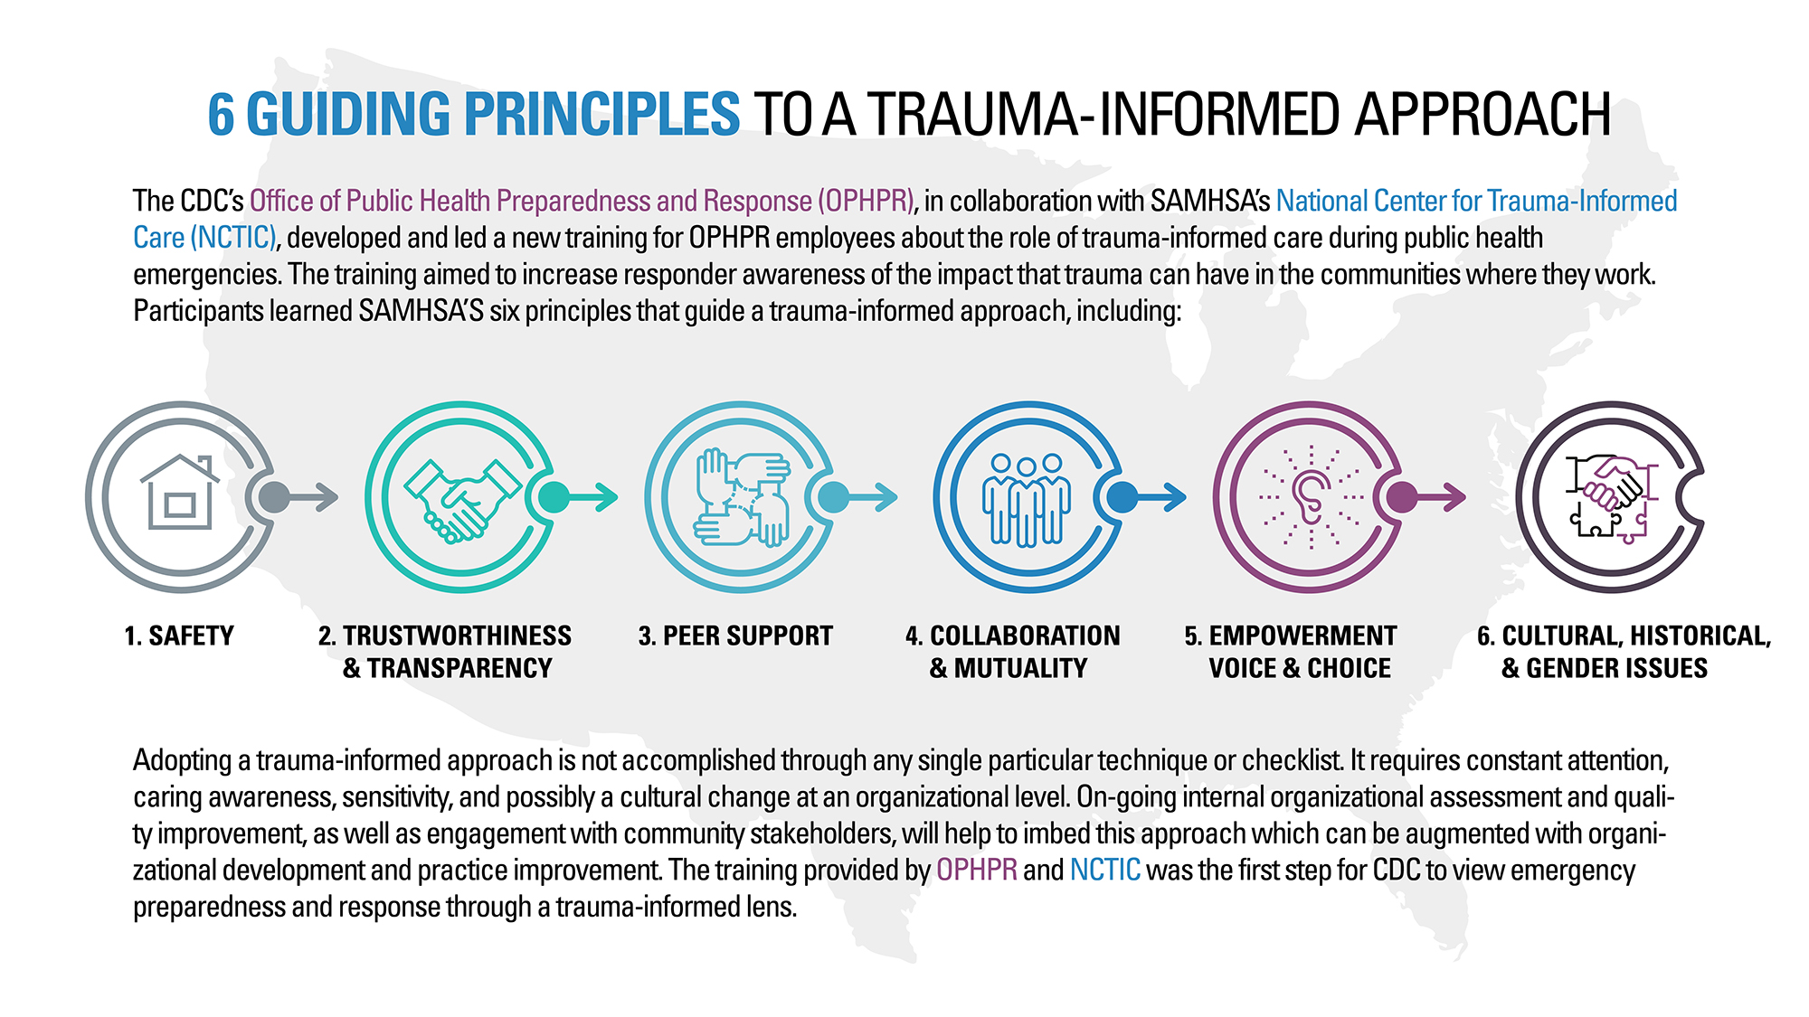
Respond: Reframing our Approach
“What happened to you?”
https://www.cdc.gov/cpr/infographics/6_principles_trauma_info.htm
Notes:
How to help combat this trauma?
SAMHSA (Substance Abuse and Mental Health Services Administration) Trauma Informed Approach Asks “What happened to you?” instead of "What's wrong with you?"
SAMHSA shares the six key principles of trauma informed care as follows:
Safety – trust and safety is mutually defined
Trustworthiness & Transparency – organizational operations and decisions are conducted with transparency; goal of building trust with staff, client families
Peer Support – and mutual self help are key for establishing safety and hope, building trust, and collaboration
Collaboration & Mutuality –Importance placed on partnering and leveling power differences between staff & clients; Everyone has a role to play
Empowerment, Voice and Choice – Organization and clients strengths and experiences are recognized and built upon. Shared decision making, choice, and goal setting
Cultural, Historical, and Gender Issues – the organization moves past cultural stereotypes and biases (race, gender, age, sexual orientation etc) Policies and practices are responsive to gender, racial, ethnic and cultural needs of individuals, recognizes historical trauma.
Resources:
https://ncsacw.samhsa.gov/userfiles/files/SAMHSA_Trauma.pdf
https://www.cdc.gov/cpr/infographics/6_principles_trauma_info.htm

Slide 19
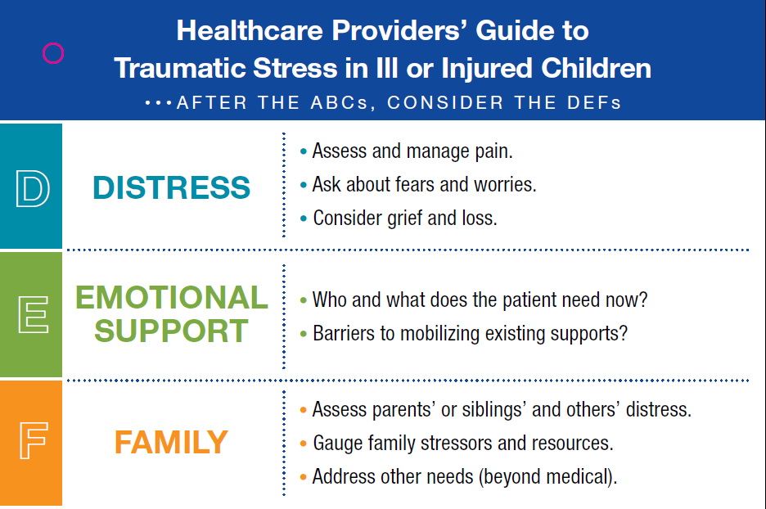
Respond: DEF Protocol
Heathcaretoolbox.org
Notes:
D-E-F is an acronym that is helpful in for healthcare professionals to use when assessing traumatic stress in patients and their families.
D- Distress of the patient
E- Emotional Support needed by the patient
F- Family Needs at this time
www.healthcaretoolbox.org

Slide 20
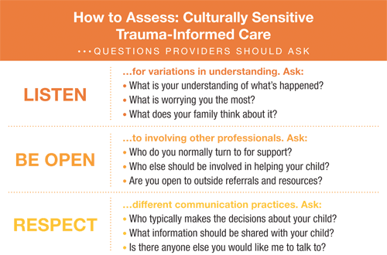
Respond: Considerations in providing Culturally-Sensitive Trauma-Informed Care
Culture includes, but is not limited to:
  Religious beliefs
  Socioeconomic status
  Gender
  Sexual identity
  Literacy level
  Residency
Notes:
View relationships, assessments and treatments through a Culturally-Sensitive Trauma-Informed Lens
Culture is more than race and ethnicity
The capacity for health care professionals to effectually provide trauma-informed assessment and intervention that acknowledges, respects, and integrates patients' and families' cultural values, beliefs, and practices.
As in all pediatric care, Culturally-Sensitive Trauma-Informed Care requires attention to be paid to a child's and family's values and beliefs about health and illness.
- What's unique is that attention must also be paid to cultural variations in the child's and family's experience of and response to trauma.
Research suggests that although there is a universal biological response to trauma, cultural factors can influence the biopsychosocial experience of trauma and subsequent traumatic stress reactions.
Ethno-cultural factors play an important role in an individual's vulnerability to, experience and expression of traumatic stress, as well as their response to trauma treatment.
Culture includes, but is not limited to:
Religious beliefs
Socioeconomic status
Gender
Sexual identity
Literacy level
Residency
Keep in mind the current political and social contexts in which we are living
Culturally-Sensitive Trauma informed care is a great way to incorporate family centered care into your practice and culturally sensitive trauma informed care is based upon listening, being open, and respecting the different cultural practices of everyone that we care for. Recognizing that what some patients need at the time of their treatment may differ from what you or your family would need in that moment. So we want to:
Listen to their understanding of the situation, their worries and thoughts
Be Open to who they want by their side, what kind of help they are seeking
And Respect the ways in which they communicate about what they need at that time.
Ultimately, it is good practice to view all relationships, assessments and treatments through a culturally sensitive trauma informed lens
View RELATIONSHIPS through a Culturally-Sensitive Trauma-Informed lens
Understand your role as a provider within this family's world.
Gain a better understanding of the roles and dynamics within this family.
Consider and facilitate the inclusion of others (extended family, clergy, healers) when treating patients.
View ASSESSMENT through a Culturally-Sensitive Trauma-Informed lens
The manifestation and expression of psychological states differ depending on personal, familial, and cultural beliefs and practices.
Listen to and use the family's own terms during assessment and treatment planning
Trust in / comfort with the provider is vital and it’s up to us to promote trust.
View TREATMENT through a Culturally-Sensitive Trauma-Informed lens
Healing comes in many different forms; your ideas, beliefs, and values may differ from the family's.
Be sure you have integrated the family's understanding of diagnosis, prognosis, and healing into your treatment planning.
Consider each family's resources and barriers to help-seeking and utilization of supportive services within the community.
Resources:
https://healthcaretoolbox.org/cultural-considerations
“How Racism Can Affect Child Development”: https://developingchild.harvard.edu/resources/racism-and-ecd/

Slide 21
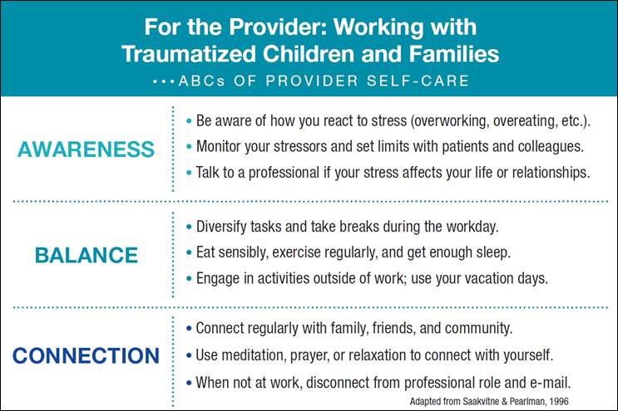
Respond: ABCs of Provider Self Care
Heathcaretoolbox.org
Notes:
One way to think about what you can do as an individual, is to remember Awareness, Balance, and Connection - ABC.
This means:
Monitoring your reactions and being AWARE of changes
Maintaining BALANCE in personal and work lives
Staying CONNECTED to loved ones and trusted colleagues
Both individually and organizationally
Individual
Self care
Know when to say “no”
Take inventory of what you spend time doing vs. what you enjoy doing
Stay social- interact with people in other specialties
Vacations- Take them!
Balancing your work- "Some trauma treaters find it helpful to balance their trauma work with other work“ -ISTSS
Awareness
Personal triggers
Personal boundaries
Balance:
Work-life balance
Organization:
In terms of thinking organizationally, take time to consider what resources are available within your instition. Consider:
Does the organization Seek out or recognize whether the organization that you work for values and supports work-life balance
Does the organization recognize that all staff may be impacted by this work
Does the organization value avenues for teams to acknowledge and debrief after challenging incidents, cases or situations.
Organizational
Support programs for caregivers
Encouraging work-life balance
Self-scheduling
Mandatory breaks
Staff resources like disruption free lunch breaks or places to step away if needed
Culture of safety encouraged between peers and management
Organizational support can include
Psychoeducation
Skills training
Staff retreats
Clinical group supervision
Case conferencing
Self-report screening
Workplace self-care groups
Work/life balance
Flexible scheduling
Employee assistance programs
Use of evidence-based practices
www.healthcaretoolbox.com
Organizational Support for Self Care
Is there a self-care culture in the organization?
Recognize contributions and effort
Incorporate trauma informed principals with staff/each other
Clinical Group Supervision
Case conferencing
Obtain staff input on policy and procedure development
Recognize staff have their own trauma histories
Job hazard- responsibility of the employer and team leaders to incorporate structural changes so that we are protected. Specific team needs.

Slide 22
Respond: What is the impact?
“The changes helpers experience in their identities, world views, and spirituality affect both the helpers’ professional relationships with clients and colleagues and their personal relationships.”
– International Society for Traumatic Stress Studies (ISTSS)
Secondary traumatic stress can impact patient care.
Notes:
Secondary traumatic stress can have impact on the physical and mental health and well-being of the health care professional. This traumatic stress can impact the healthcare professional’s professional as well as personal life. It can contribute to discord and distress within the health care professional’s home life. The impact that secondary traumatic stress may have on an individual health care professional’s work can have an impact on the larger health care team and may cause issues such as tension or conflict, miscommunication and can even result in concerns regarding patient safety and quality of care.
STS may contribute to:
Tension or conflicts with patients & families
Stresses within the interdisciplinary health care team
Miscommunication

Slide 23
Resist: re-traumatization through actions performed while in our care

Slide 24
Resist: Potential for new trauma/ re-traumatization
Our #1 goal…
is to minimize potentially traumatic aspects of care and reduce the chances that we will re-traumatize patients and families while in our care.
.
Notes:
When patients and families are being cared for, sometimes uncomfortable and even painful experiences may be required during their care. It is the goal of healthcare professionals to limit and minimize the amount of discomfort that is experienced while performing medical care.

Slide 25
Additional Resources

Slide 26
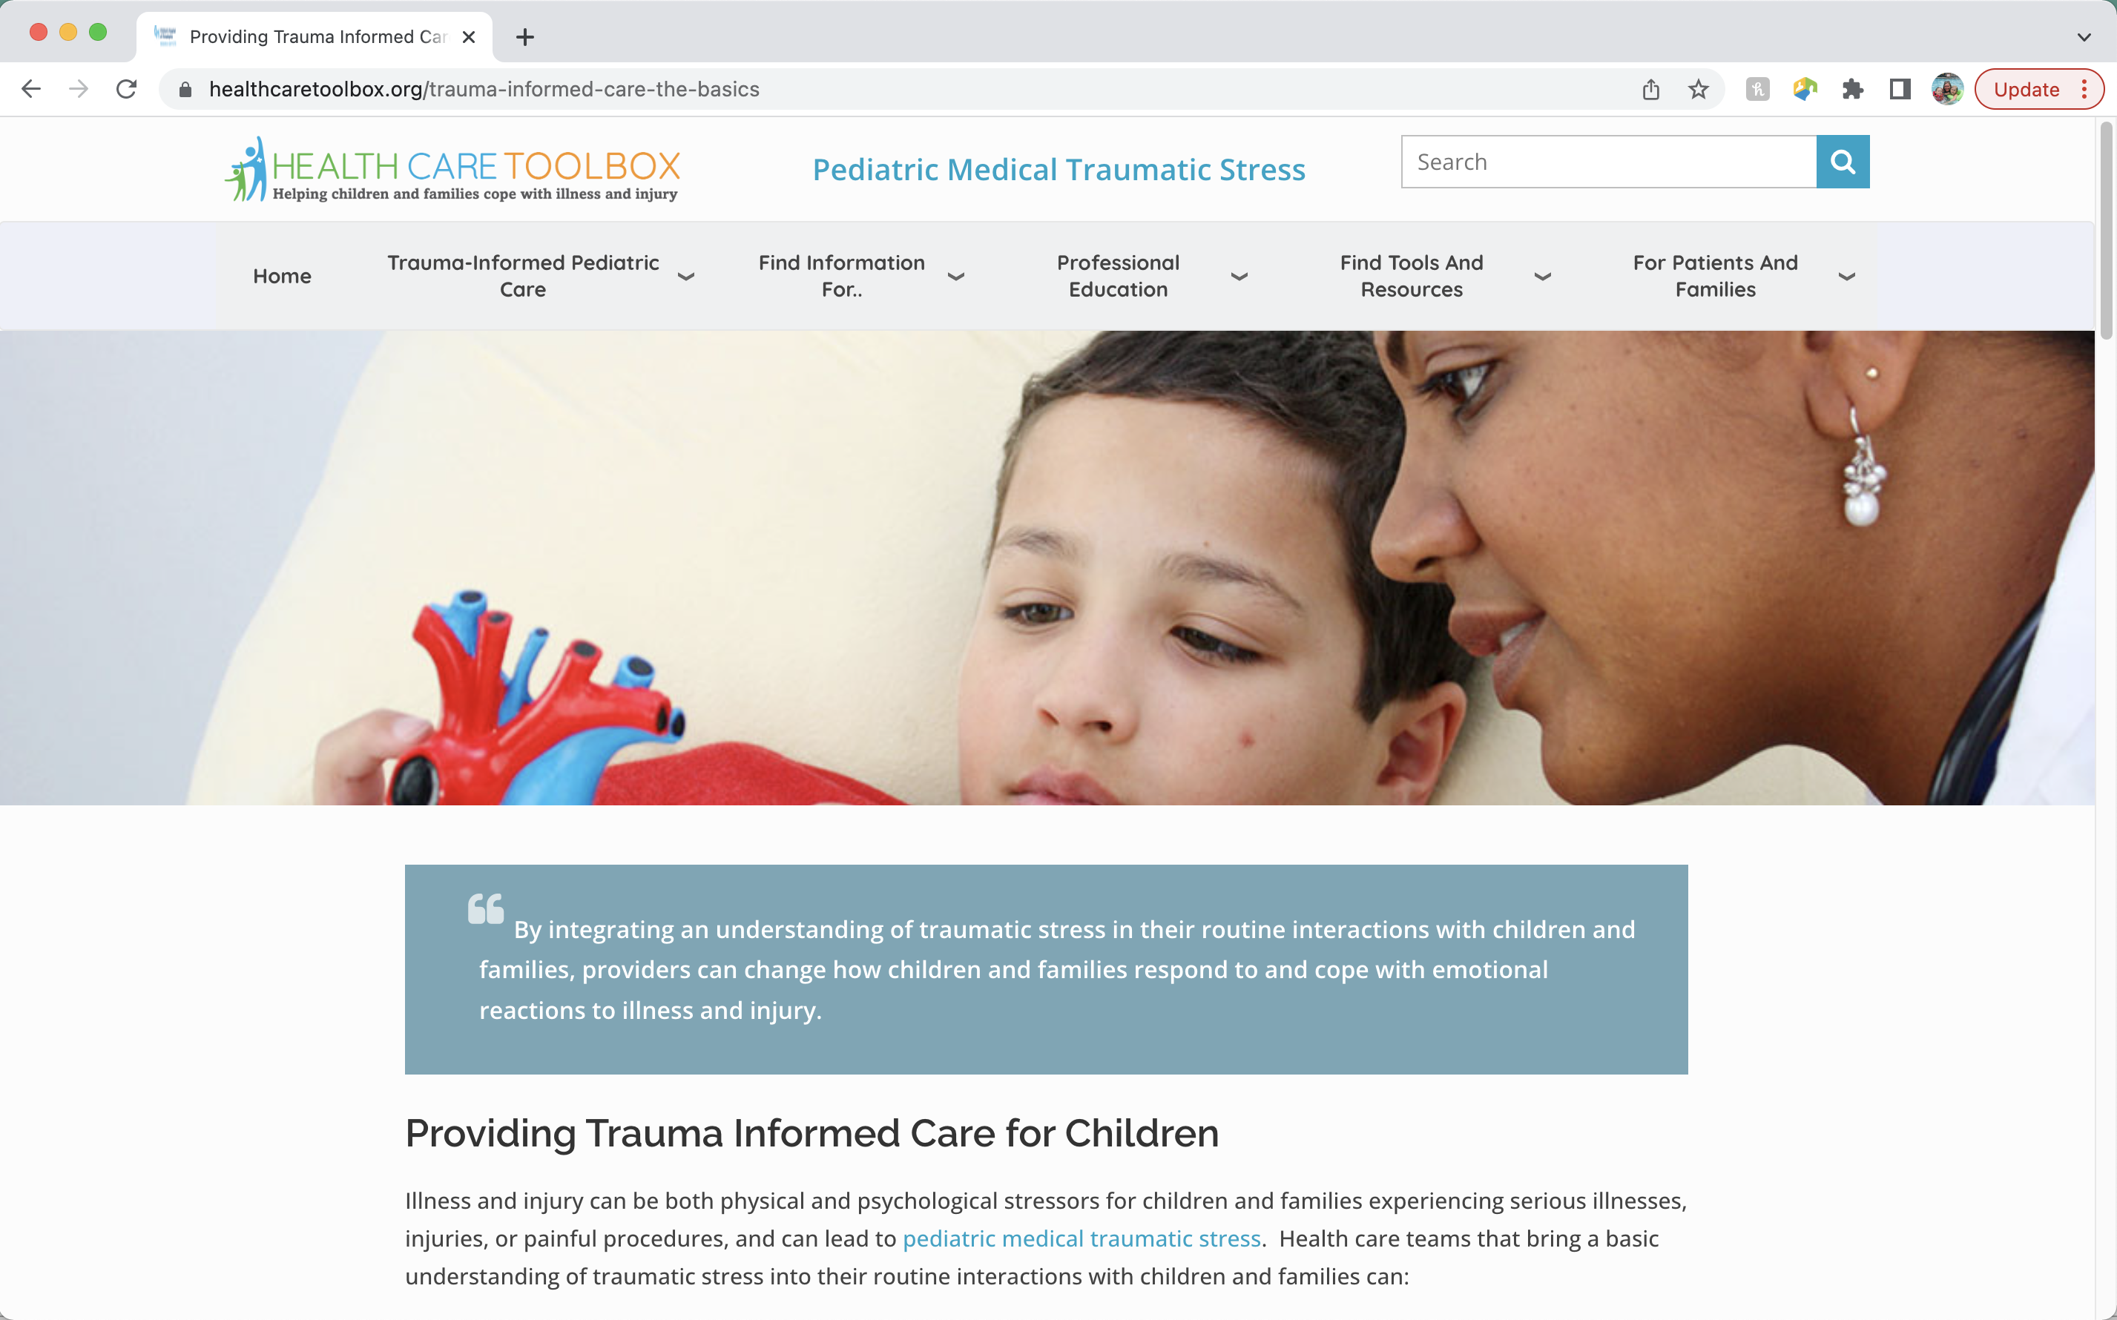
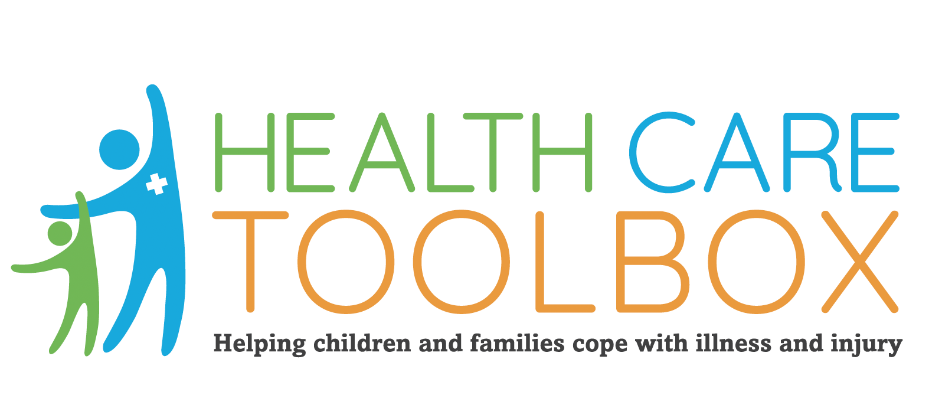
www.HealthCareToolbox.org
Heathcaretoolbox.org
Notes:
HealthCare Toolbox is the website for the Center for Pediatric Traumatic Stress, the sponsor for this project. The Center for Pediatric Traumatic Stress is a member of the National Traumatic Stress Network. The mission of the Center for Pediatric Traumatic Stress is to reduce pediatric medical traumatic stress through promoting trauma-informed healthcare, disseminating evidence-based practices and screening tools to pediatric healthcare providers and training providers to recognize and address traumatic stress in children.

Slide 27
Resources
ACEs Connection: http://acesconnection.com
After the Injury: https://www.aftertheinjury.org/
CDC: www.cdc.gov/violenceprevention/acestudy
Center for the Developing Child- Harvard University: https://developingchild.harvard.edu/
International Society for Traumatic Stress Studies (ISTSS): https://istss.org/home
National Child Traumatic Stress Network: https://www.nctsn.org/
Original ACE Study: www.acestudy.org
National Center for PTSD - www.ncptsd.org
Notes:
Resources that are relevant to this information and have been referenced throughout the presentation.

Slide 28
Resources
Tools/Apps:
Headspace- www.headspace.com
Calm.com- www.calm.com
Helpguide- www.helpguide.org
Mind Tools- www.mindtools.com
Pacifica- www.thinkpacifica.com
Children’s book- https://www.mindheart.co/descargables
Notes:
Resources that are relevant to this information.

Slide 29


